Slide 1

W H A R T O N
01
02
Ultra-Thin Stone
MARBLE SERIES
JADE SERIES
SINTERED
STONE
CATALOG
Luxury Natural Stone
Premium Stone
03
04
TRAVERTINE
LIMESTONE
Natural Texture
Subtle Elegance
Expert in 3 & 6MM
Ultra-Thin Sintered Stone
05
06
253 Products · 2026
METAL SERIES
SOLID COLOR
Modern Industrial
Minimalist
www.whartonstone.com | apple@whartonstone.com | +86 139 2313 0743

Slide 2
GDJINQIANG
2
岩板一线品牌、大规格岩板、专业岩板品牌
FINISH
SILK
THICKNESS
12 mm
FORMAT
1600x3200 mm | 63x126 inch
AVAILABLE THICKNESS
6mm | 3.5mm | 3mm
SHEET SIZE
6mm: 1600x3200 | 3mm: 1000x3000
NET WEIGHT
6mm: 14.5 kg/m2 | 3mm: 7.2 kg/m2
SERIE
GDJINQIANG ORIGINAL
REFERENCE
WT2
MORE VIEWS

Slide 3
GDJINQIANG
3
岩板一线品牌、大规格岩板、专业岩板品牌
FINISH
SILK
THICKNESS
12 mm
FORMAT
1600x3200 mm | 63x126 inch
AVAILABLE THICKNESS
6mm | 3.5mm | 3mm
SHEET SIZE
6mm: 1600x3200 | 3mm: 1000x3000
NET WEIGHT
6mm: 14.5 kg/m2 | 3mm: 7.2 kg/m2
SERIE
GDJINQIANG ORIGINAL
REFERENCE
WT2
MORE VIEWS

Slide 4
GDJINQIANG
4
岩板一线品牌、大规格岩板、专业岩板品牌
FINISH
SILK
THICKNESS
12 mm
FORMAT
1600x3200 mm | 63x126 inch
AVAILABLE THICKNESS
6mm | 3.5mm | 3mm
SHEET SIZE
6mm: 1600x3200 | 3mm: 1000x3000
NET WEIGHT
6mm: 14.5 kg/m2 | 3mm: 7.2 kg/m2
SERIE
GDJINQIANG ORIGINAL
REFERENCE
WT2
MORE VIEWS

Slide 5
GDJINQIANG
5
岩板一线品牌、大规格岩板、专业岩板品牌
FINISH
SILK
THICKNESS
12 mm
FORMAT
1600x3200 mm | 63x126 inch
AVAILABLE THICKNESS
6mm | 3.5mm | 3mm
SHEET SIZE
6mm: 1600x3200 | 3mm: 1000x3000
NET WEIGHT
6mm: 14.5 kg/m2 | 3mm: 7.2 kg/m2
SERIE
GDJINQIANG ORIGINAL
REFERENCE
WT2
MORE VIEWS

Slide 6
GDJINQIANG
6
岩板一线品牌、大规格岩板、专业岩板品牌
FINISH
SILK
THICKNESS
12 mm
FORMAT
1600x3200 mm | 63x126 inch
AVAILABLE THICKNESS
6mm | 3.5mm | 3mm
SHEET SIZE
6mm: 1600x3200 | 3mm: 1000x3000
NET WEIGHT
6mm: 14.5 kg/m2 | 3mm: 7.2 kg/m2
SERIE
GDJINQIANG ORIGINAL
REFERENCE
WT2
MORE VIEWS

Slide 7
GDJINQIANG
7
岩板一线品牌、大规格岩板、专业岩板品牌
FINISH
SILK
THICKNESS
12 mm
FORMAT
1600x3200 mm | 63x126 inch
AVAILABLE THICKNESS
6mm | 3.5mm | 3mm
SHEET SIZE
6mm: 1600x3200 | 3mm: 1000x3000
NET WEIGHT
6mm: 14.5 kg/m2 | 3mm: 7.2 kg/m2
SERIE
GDJINQIANG ORIGINAL
REFERENCE
WT2
MORE VIEWS

Slide 8
GDJINQIANG
8
岩板一线品牌、大规格岩板、专业岩板品牌
FINISH
SILK
THICKNESS
12 mm
FORMAT
1600x3200 mm | 63x126 inch
AVAILABLE THICKNESS
6mm | 3.5mm | 3mm
SHEET SIZE
6mm: 1600x3200 | 3mm: 1000x3000
NET WEIGHT
6mm: 14.5 kg/m2 | 3mm: 7.2 kg/m2
SERIE
GDJINQIANG ORIGINAL
REFERENCE
WT2
MORE VIEWS

Slide 9
GDJINQIANG
9
岩板一线品牌、大规格岩板、专业岩板品牌
FINISH
SILK
THICKNESS
12 mm
FORMAT
1600x3200 mm | 63x126 inch
AVAILABLE THICKNESS
6mm | 3.5mm | 3mm
SHEET SIZE
6mm: 1600x3200 | 3mm: 1000x3000
NET WEIGHT
6mm: 14.5 kg/m2 | 3mm: 7.2 kg/m2
SERIE
GDJINQIANG ORIGINAL
REFERENCE
WT2
MORE VIEWS

Slide 10
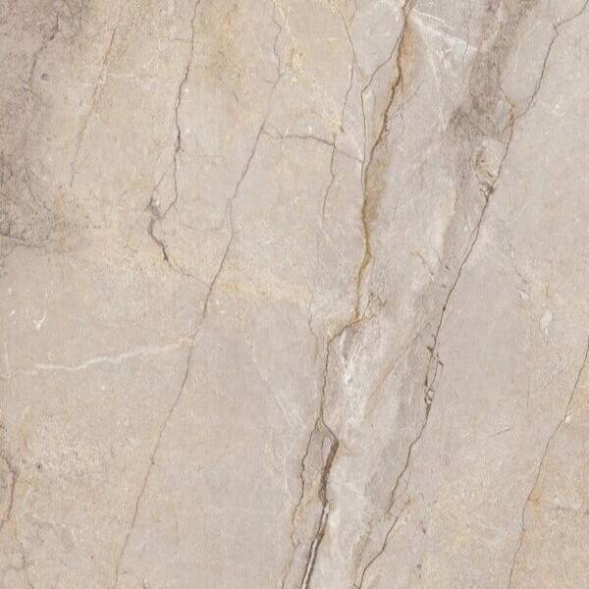

TECHLAM
10
CEPPO
FINISH
SILK
THICKNESS
12 mm
FORMAT
1600x3200 mm | 63x126 inch
AVAILABLE THICKNESS
6mm | 3.5mm | 3mm
SHEET SIZE
6mm: 1600x3200 | 3mm: 1000x3000
NET WEIGHT
6mm: 14.5 kg/m2 | 3mm: 7.2 kg/m2
SERIE
TECHLAM COLLECTION
REFERENCE
WT1008
MORE VIEWS

Slide 11
TECHLAM
11
FOREST
FINISH
POLISHED
THICKNESS
12 mm
FORMAT
1600x3200 mm | 63x126 inch
AVAILABLE THICKNESS
6mm | 3.5mm | 3mm
SHEET SIZE
6mm: 1600x3200 | 3mm: 1000x3000
NET WEIGHT
6mm: 14.5 kg/m2 | 3mm: 7.2 kg/m2
SERIE
TECHLAM COLLECTION
REFERENCE
WT1009
MORE VIEWS

Slide 12
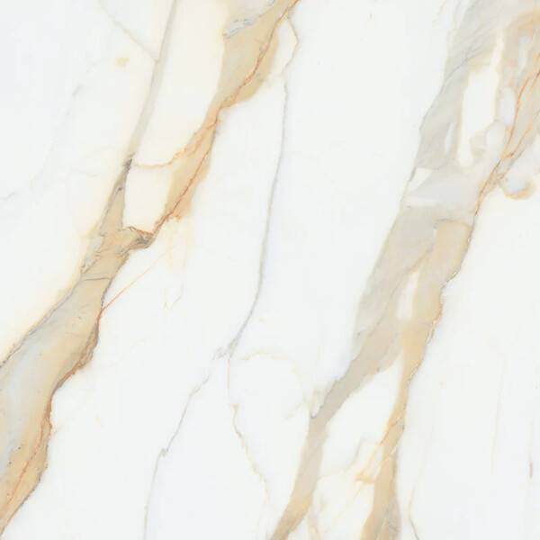
TECHLAM
12
KALEDONIA
FINISH
POLISHED
THICKNESS
12 mm
FORMAT
1600x3200 mm | 63x126 inch
AVAILABLE THICKNESS
6mm | 3.5mm | 3mm
SHEET SIZE
6mm: 1600x3200 | 3mm: 1000x3000
NET WEIGHT
6mm: 14.5 kg/m2 | 3mm: 7.2 kg/m2
SERIE
TECHLAM COLLECTION
REFERENCE
WT1010
MORE VIEWS

Slide 13
TECHLAM
13
NUVOLA
FINISH
POLISHED
THICKNESS
12 mm
FORMAT
1600x3200 mm | 63x126 inch
AVAILABLE THICKNESS
6mm | 3.5mm | 3mm
SHEET SIZE
6mm: 1600x3200 | 3mm: 1000x3000
NET WEIGHT
6mm: 14.5 kg/m2 | 3mm: 7.2 kg/m2
SERIE
TECHLAM COLLECTION
REFERENCE
WT1011
MORE VIEWS

Slide 14
TECHLAM
14
PATAGONIA
FINISH
POLISHED
THICKNESS
12 mm
FORMAT
1600x3200 mm | 63x126 inch
AVAILABLE THICKNESS
6mm | 3.5mm | 3mm
SHEET SIZE
6mm: 1600x3200 | 3mm: 1000x3000
NET WEIGHT
6mm: 14.5 kg/m2 | 3mm: 7.2 kg/m2
SERIE
TECHLAM COLLECTION
REFERENCE
WT1012
MORE VIEWS

Slide 15
TECHLAM
15
STARLIGHT
FINISH
POLISHED
THICKNESS
12 mm
FORMAT
1600x3200 mm | 63x126 inch
AVAILABLE THICKNESS
6mm | 3.5mm | 3mm
SHEET SIZE
6mm: 1600x3200 | 3mm: 1000x3000
NET WEIGHT
6mm: 14.5 kg/m2 | 3mm: 7.2 kg/m2
SERIE
TECHLAM COLLECTION
REFERENCE
WT1013
MORE VIEWS

Slide 16

TECHLAM
16
SUPERGREY
FINISH
POLISHED
THICKNESS
12 mm
FORMAT
1600x3200 mm | 63x126 inch
AVAILABLE THICKNESS
6mm | 3.5mm | 3mm
SHEET SIZE
6mm: 1600x3200 | 3mm: 1000x3000
NET WEIGHT
6mm: 14.5 kg/m2 | 3mm: 7.2 kg/m2
SERIE
TECHLAM COLLECTION
REFERENCE
WT1014
MORE VIEWS

Slide 17
TECHLAM
17
TROPICAL GREEN
FINISH
POLISHED
THICKNESS
12 mm
FORMAT
1600x3200 mm | 63x126 inch
AVAILABLE THICKNESS
6mm | 3.5mm | 3mm
SHEET SIZE
6mm: 1600x3200 | 3mm: 1000x3000
NET WEIGHT
6mm: 14.5 kg/m2 | 3mm: 7.2 kg/m2
SERIE
TECHLAM COLLECTION
REFERENCE
WT1015
MORE VIEWS

Slide 18
WHARTONSTONE
18
CHINA CALACATTA GOLD VENATO BNL1239L15 3000X1200X9MM MANUFACTURER, FACTORY | WHARTON
FINISH
POLISHED
THICKNESS
12 mm
FORMAT
1600x3200 mm | 63x126 inch
AVAILABLE THICKNESS
6mm | 3.5mm | 3mm
SHEET SIZE
6mm: 1600x3200 | 3mm: 1000x3000
NET WEIGHT
6mm: 14.5 kg/m2 | 3mm: 7.2 kg/m2
SERIE
WHARTON ORIGINAL
REFERENCE
WT9
MORE VIEWS

Slide 19
WHARTONSTONE
19
CHINA FENDI WHITE ONYX 1279497L/1279497F 2700X1200X9MM MANUFACTURER, FACTORY | WHARTON
FINISH
POLISHED
THICKNESS
12 mm
FORMAT
1600x3200 mm | 63x126 inch
AVAILABLE THICKNESS
6mm | 3.5mm | 3mm
SHEET SIZE
6mm: 1600x3200 | 3mm: 1000x3000
NET WEIGHT
6mm: 14.5 kg/m2 | 3mm: 7.2 kg/m2
SERIE
WHARTON ORIGINAL
REFERENCE
WT9
MORE VIEWS

Slide 20
WHARTONSTONE
20
CHINA FENDI WHITE ONYX 1539497L 3000X1500X9MM MANUFACTURER, FACTORY | WHARTON
FINISH
POLISHED
THICKNESS
12 mm
FORMAT
1600x3200 mm | 63x126 inch
AVAILABLE THICKNESS
6mm | 3.5mm | 3mm
SHEET SIZE
6mm: 1600x3200 | 3mm: 1000x3000
NET WEIGHT
6mm: 14.5 kg/m2 | 3mm: 7.2 kg/m2
SERIE
WHARTON ORIGINAL
REFERENCE
WT9
MORE VIEWS

Slide 21
WHARTONSTONE
21
CHINA FENDI WHITE ONYX BNL1632497L/BNL1632497YS 3200X1600X12MM MANUFACTURER, FACTORY | WHARTON
FINISH
POLISHED
THICKNESS
12 mm
FORMAT
1600x3200 mm | 63x126 inch
AVAILABLE THICKNESS
6mm | 3.5mm | 3mm
SHEET SIZE
6mm: 1600x3200 | 3mm: 1000x3000
NET WEIGHT
6mm: 14.5 kg/m2 | 3mm: 7.2 kg/m2
SERIE
WHARTON ORIGINAL
REFERENCE
WT12
MORE VIEWS

Slide 22
WHARTONSTONE
22
CHINA FENDI WHITE ONYX BNL9262497L 2600X900X9MM MANUFACTURER, FACTORY | WHARTON
FINISH
POLISHED
THICKNESS
12 mm
FORMAT
1600x3200 mm | 63x126 inch
AVAILABLE THICKNESS
6mm | 3.5mm | 3mm
SHEET SIZE
6mm: 1600x3200 | 3mm: 1000x3000
NET WEIGHT
6mm: 14.5 kg/m2 | 3mm: 7.2 kg/m2
SERIE
WHARTON ORIGINAL
REFERENCE
WT9
MORE VIEWS

Slide 23
WHARTONSTONE
23
CHINA GINKGO CREAM BNL82691158F 2600X800X9MM MANUFACTURER, FACTORY | WHARTON
FINISH
MATTE
THICKNESS
12 mm
FORMAT
1600x3200 mm | 63x126 inch
AVAILABLE THICKNESS
6mm | 3.5mm | 3mm
SHEET SIZE
6mm: 1600x3200 | 3mm: 1000x3000
NET WEIGHT
6mm: 14.5 kg/m2 | 3mm: 7.2 kg/m2
SERIE
WHARTON ORIGINAL
REFERENCE
WT1021
MORE VIEWS

Slide 24
WHARTONSTONE
24
CHINA INFINITE JADE ONYX BNL1279388L 2700X1200X9MM MANUFACTURER, FACTORY | WHARTON
FINISH
POLISHED
THICKNESS
12 mm
FORMAT
1600x3200 mm | 63x126 inch
AVAILABLE THICKNESS
6mm | 3.5mm | 3mm
SHEET SIZE
6mm: 1600x3200 | 3mm: 1000x3000
NET WEIGHT
6mm: 14.5 kg/m2 | 3mm: 7.2 kg/m2
SERIE
WHARTON ORIGINAL
REFERENCE
WT9
MORE VIEWS

Slide 25
WHARTONSTONE
25
CHINA INFINITE JADE ONYX BNL926388L 2600X900X9MM MANUFACTURER, FACTORY | WHARTON
FINISH
POLISHED
THICKNESS
12 mm
FORMAT
1600x3200 mm | 63x126 inch
AVAILABLE THICKNESS
6mm | 3.5mm | 3mm
SHEET SIZE
6mm: 1600x3200 | 3mm: 1000x3000
NET WEIGHT
6mm: 14.5 kg/m2 | 3mm: 7.2 kg/m2
SERIE
WHARTON ORIGINAL
REFERENCE
WT9
MORE VIEWS

Slide 26
WHARTONSTONE
26
CHINA INFINITE JADE ONYX DQS12712L04 2700X1200X12MM MANUFACTURER, FACTORY | WHARTON
FINISH
POLISHED
THICKNESS
12 mm
FORMAT
1600x3200 mm | 63x126 inch
AVAILABLE THICKNESS
6mm | 3.5mm | 3mm
SHEET SIZE
6mm: 1600x3200 | 3mm: 1000x3000
NET WEIGHT
6mm: 14.5 kg/m2 | 3mm: 7.2 kg/m2
SERIE
WHARTON ORIGINAL
REFERENCE
WT12
MORE VIEWS

Slide 27
WHARTONSTONE
27
CHINA MILANO TRAVERTINE BEIGE BNL1539465Y 3000X1000X9MM MANUFACTURER, FACTORY | WHARTON
FINISH
POLISHED
THICKNESS
12 mm
FORMAT
1600x3200 mm | 63x126 inch
AVAILABLE THICKNESS
6mm | 3.5mm | 3mm
SHEET SIZE
6mm: 1600x3200 | 3mm: 1000x3000
NET WEIGHT
6mm: 14.5 kg/m2 | 3mm: 7.2 kg/m2
SERIE
WHARTON ORIGINAL
REFERENCE
WT1025
MORE VIEWS

Slide 28
WHARTONSTONE
28
CHINA TAJ MAHAL 1632683L/1632683YS 3200X1600X12MM MANUFACTURER, FACTORY | WHARTON
FINISH
POLISHED
THICKNESS
12 mm
FORMAT
1600x3200 mm | 63x126 inch
AVAILABLE THICKNESS
6mm | 3.5mm | 3mm
SHEET SIZE
6mm: 1600x3200 | 3mm: 1000x3000
NET WEIGHT
6mm: 14.5 kg/m2 | 3mm: 7.2 kg/m2
SERIE
WHARTON ORIGINAL
REFERENCE
WT12
MORE VIEWS

Slide 29
SHUNHUITECH
29
利古里亚灰-顺辉天成岩板官网
FINISH
SILK
THICKNESS
6 mm
FORMAT
1600x3200 mm | 63x126 inch
AVAILABLE THICKNESS
6mm | 3.5mm | 3mm
SHEET SIZE
6mm: 1600x3200 | 3mm: 1000x3000
NET WEIGHT
6mm: 14.5 kg/m2 | 3mm: 7.2 kg/m2
SERIE
SHUNHUI ORIGINAL
REFERENCE
WT891
MORE VIEWS

Slide 30
SHUNHUITECH
30
利古里亚灰-顺辉天成岩板官网
FINISH
SILK
THICKNESS
6 mm
FORMAT
1600x3200 mm | 63x126 inch
AVAILABLE THICKNESS
6mm | 3.5mm | 3mm
SHEET SIZE
6mm: 1600x3200 | 3mm: 1000x3000
NET WEIGHT
6mm: 14.5 kg/m2 | 3mm: 7.2 kg/m2
SERIE
SHUNHUI ORIGINAL
REFERENCE
WT892
MORE VIEWS

Slide 31
SHUNHUITECH
31
墨玉黑-顺辉天成岩板官网
FINISH
SILK
THICKNESS
6 mm
FORMAT
1600x3200 mm | 63x126 inch
AVAILABLE THICKNESS
6mm | 3.5mm | 3mm
SHEET SIZE
6mm: 1600x3200 | 3mm: 1000x3000
NET WEIGHT
6mm: 14.5 kg/m2 | 3mm: 7.2 kg/m2
SERIE
SHUNHUI ORIGINAL
REFERENCE
WT897
MORE VIEWS

Slide 32
SHUNHUITECH
32
天青·深灰-顺辉天成岩板官网
FINISH
SILK
THICKNESS
6 mm
FORMAT
1600x3200 mm | 63x126 inch
AVAILABLE THICKNESS
6mm | 3.5mm | 3mm
SHEET SIZE
6mm: 1600x3200 | 3mm: 1000x3000
NET WEIGHT
6mm: 14.5 kg/m2 | 3mm: 7.2 kg/m2
SERIE
SHUNHUI ORIGINAL
REFERENCE
WT898
MORE VIEWS

Slide 33
SHUNHUITECH
33
帕利桑多白-顺辉天成岩板官网
FINISH
SILK
THICKNESS
6 mm
FORMAT
1600x3200 mm | 63x126 inch
AVAILABLE THICKNESS
6mm | 3.5mm | 3mm
SHEET SIZE
6mm: 1600x3200 | 3mm: 1000x3000
NET WEIGHT
6mm: 14.5 kg/m2 | 3mm: 7.2 kg/m2
SERIE
SHUNHUI ORIGINAL
REFERENCE
WT889
MORE VIEWS

Slide 34
SHUNHUITECH
34
帕利桑多白-顺辉天成岩板官网
FINISH
SILK
THICKNESS
6 mm
FORMAT
1600x3200 mm | 63x126 inch
AVAILABLE THICKNESS
6mm | 3.5mm | 3mm
SHEET SIZE
6mm: 1600x3200 | 3mm: 1000x3000
NET WEIGHT
6mm: 14.5 kg/m2 | 3mm: 7.2 kg/m2
SERIE
SHUNHUI ORIGINAL
REFERENCE
WT890
MORE VIEWS

Slide 35
SHUNHUITECH
35
毕加索粉-顺辉天成岩板官网
FINISH
SILK
THICKNESS
6 mm
FORMAT
1600x3200 mm | 63x126 inch
AVAILABLE THICKNESS
6mm | 3.5mm | 3mm
SHEET SIZE
6mm: 1600x3200 | 3mm: 1000x3000
NET WEIGHT
6mm: 14.5 kg/m2 | 3mm: 7.2 kg/m2
SERIE
SHUNHUI ORIGINAL
REFERENCE
WT884
MORE VIEWS

Slide 36
SHUNHUITECH
36
磐境-顺辉天成岩板官网
FINISH
SILK
THICKNESS
6 mm
FORMAT
1600x3200 mm | 63x126 inch
AVAILABLE THICKNESS
6mm | 3.5mm | 3mm
SHEET SIZE
6mm: 1600x3200 | 3mm: 1000x3000
NET WEIGHT
6mm: 14.5 kg/m2 | 3mm: 7.2 kg/m2
SERIE
SHUNHUI ORIGINAL
REFERENCE
WT885
MORE VIEWS

Slide 37
SHUNHUITECH
37
磐境-顺辉天成岩板官网
FINISH
SILK
THICKNESS
6 mm
FORMAT
1600x3200 mm | 63x126 inch
AVAILABLE THICKNESS
6mm | 3.5mm | 3mm
SHEET SIZE
6mm: 1600x3200 | 3mm: 1000x3000
NET WEIGHT
6mm: 14.5 kg/m2 | 3mm: 7.2 kg/m2
SERIE
SHUNHUI ORIGINAL
REFERENCE
WT886
MORE VIEWS

Slide 38
SHUNHUITECH
38
莫奈花园-顺辉天成岩板官网
FINISH
SILK
THICKNESS
6 mm
FORMAT
1600x3200 mm | 63x126 inch
AVAILABLE THICKNESS
6mm | 3.5mm | 3mm
SHEET SIZE
6mm: 1600x3200 | 3mm: 1000x3000
NET WEIGHT
6mm: 14.5 kg/m2 | 3mm: 7.2 kg/m2
SERIE
SHUNHUI ORIGINAL
REFERENCE
WT883
MORE VIEWS

Slide 39
SHUNHUITECH
39
顶级雪花白-顺辉天成岩板官网
FINISH
SILK
THICKNESS
6 mm
FORMAT
1600x3200 mm | 63x126 inch
AVAILABLE THICKNESS
6mm | 3.5mm | 3mm
SHEET SIZE
6mm: 1600x3200 | 3mm: 1000x3000
NET WEIGHT
6mm: 14.5 kg/m2 | 3mm: 7.2 kg/m2
SERIE
SHUNHUI ORIGINAL
REFERENCE
WT887
MORE VIEWS

Slide 40
SHUNHUITECH
40
顶级雪花白-顺辉天成岩板官网
FINISH
SILK
THICKNESS
6 mm
FORMAT
1600x3200 mm | 63x126 inch
AVAILABLE THICKNESS
6mm | 3.5mm | 3mm
SHEET SIZE
6mm: 1600x3200 | 3mm: 1000x3000
NET WEIGHT
6mm: 14.5 kg/m2 | 3mm: 7.2 kg/m2
SERIE
SHUNHUI ORIGINAL
REFERENCE
WT888
MORE VIEWS

Slide 41

JANYECERAMIC
41
LIME-STONE-BEIGE
FINISH
SILK
THICKNESS
3 mm
FORMAT
1600x3200 mm | 63x126 inch
AVAILABLE THICKNESS
6mm | 3.5mm | 3mm
SHEET SIZE
6mm: 1600x3200 | 3mm: 1000x3000
NET WEIGHT
6mm: 14.5 kg/m2 | 3mm: 7.2 kg/m2
SERIE
JANYE ORIGINAL
REFERENCE
WT1039
MORE VIEWS

Slide 42
JANYECERAMIC
42
NEW-MASA-JC1003P
FINISH
SILK
THICKNESS
3 mm
FORMAT
1600x3200 mm | 63x126 inch
AVAILABLE THICKNESS
6mm | 3.5mm | 3mm
SHEET SIZE
6mm: 1600x3200 | 3mm: 1000x3000
NET WEIGHT
6mm: 14.5 kg/m2 | 3mm: 7.2 kg/m2
SERIE
JANYE ORIGINAL
REFERENCE
WT1003
MORE VIEWS

Slide 43
JANYECERAMIC
43
SHELL-OFF-WHITE
FINISH
SILK
THICKNESS
3 mm
FORMAT
1600x3200 mm | 63x126 inch
AVAILABLE THICKNESS
6mm | 3.5mm | 3mm
SHEET SIZE
6mm: 1600x3200 | 3mm: 1000x3000
NET WEIGHT
6mm: 14.5 kg/m2 | 3mm: 7.2 kg/m2
SERIE
JANYE ORIGINAL
REFERENCE
WT1041
MORE VIEWS

Slide 44
BJS
44
" TITLE="PRODUCTS
FINISH
SILK
THICKNESS
6 mm
FORMAT
1600x3200 mm | 63x126 inch
AVAILABLE THICKNESS
6mm | 3.5mm | 3mm
SHEET SIZE
6mm: 1600x3200 | 3mm: 1000x3000
NET WEIGHT
6mm: 14.5 kg/m2 | 3mm: 7.2 kg/m2
SERIE
BJS ORIGINAL
REFERENCE
WT1042
MORE VIEWS

Slide 45
BJS
45
" TITLE="PRODUCTS
FINISH
SILK
THICKNESS
6 mm
FORMAT
1600x3200 mm | 63x126 inch
AVAILABLE THICKNESS
6mm | 3.5mm | 3mm
SHEET SIZE
6mm: 1600x3200 | 3mm: 1000x3000
NET WEIGHT
6mm: 14.5 kg/m2 | 3mm: 7.2 kg/m2
SERIE
BJS ORIGINAL
REFERENCE
WT1043
MORE VIEWS

Slide 46
BJS
46
APACHE-BLUE" CLASS="THEMES_PRODUCTS_TITLE" TITLE="APACHE BLUE
FINISH
SILK
THICKNESS
6 mm
FORMAT
1600x3200 mm | 63x126 inch
AVAILABLE THICKNESS
6mm | 3.5mm | 3mm
SHEET SIZE
6mm: 1600x3200 | 3mm: 1000x3000
NET WEIGHT
6mm: 14.5 kg/m2 | 3mm: 7.2 kg/m2
SERIE
BJS ORIGINAL
REFERENCE
WT1044
MORE VIEWS

Slide 47
BJS
47
APACHE-BLUE" TITLE="APACHE BLUE">
<IMG CLASS="OK LAZYLOAD TRANS " DATA-SIZE="AUTO" DATA-SRCSET=
FINISH
SILK
THICKNESS
6 mm
FORMAT
1600x3200 mm | 63x126 inch
AVAILABLE THICKNESS
6mm | 3.5mm | 3mm
SHEET SIZE
6mm: 1600x3200 | 3mm: 1000x3000
NET WEIGHT
6mm: 14.5 kg/m2 | 3mm: 7.2 kg/m2
SERIE
BJS ORIGINAL
REFERENCE
WT1045
MORE VIEWS

Slide 48
BJS
48
ARMANI" CLASS="THEMES_PRODUCTS_TITLE" TITLE="ARMANI
FINISH
SILK
THICKNESS
6 mm
FORMAT
1600x3200 mm | 63x126 inch
AVAILABLE THICKNESS
6mm | 3.5mm | 3mm
SHEET SIZE
6mm: 1600x3200 | 3mm: 1000x3000
NET WEIGHT
6mm: 14.5 kg/m2 | 3mm: 7.2 kg/m2
SERIE
BJS ORIGINAL
REFERENCE
WT1046
MORE VIEWS

Slide 49
BJS
49
ARMANI" TITLE="ARMANI">
<IMG CLASS="OK LAZYLOAD TRANS " DATA-SIZE="AUTO" DATA-SRCSET=
FINISH
SILK
THICKNESS
6 mm
FORMAT
1600x3200 mm | 63x126 inch
AVAILABLE THICKNESS
6mm | 3.5mm | 3mm
SHEET SIZE
6mm: 1600x3200 | 3mm: 1000x3000
NET WEIGHT
6mm: 14.5 kg/m2 | 3mm: 7.2 kg/m2
SERIE
BJS ORIGINAL
REFERENCE
WT1047
MORE VIEWS

Slide 50
BJS
50
ARMANI-LIGHT-GREY-1" CLASS="THEMES_PRODUCTS_TITLE" TITLE="ARMANI LIGHT GREY
FINISH
SILK
THICKNESS
6 mm
FORMAT
1600x3200 mm | 63x126 inch
AVAILABLE THICKNESS
6mm | 3.5mm | 3mm
SHEET SIZE
6mm: 1600x3200 | 3mm: 1000x3000
NET WEIGHT
6mm: 14.5 kg/m2 | 3mm: 7.2 kg/m2
SERIE
BJS ORIGINAL
REFERENCE
WT1
MORE VIEWS

Slide 51
BJS
51
ARMANI-LIGHT-GREY-1" TITLE="ARMANI LIGHT GREY">
<IMG CLASS="OK LAZYLOAD TRANS " DATA-SIZE="AUTO" DATA-SRCSET=
FINISH
SILK
THICKNESS
6 mm
FORMAT
1600x3200 mm | 63x126 inch
AVAILABLE THICKNESS
6mm | 3.5mm | 3mm
SHEET SIZE
6mm: 1600x3200 | 3mm: 1000x3000
NET WEIGHT
6mm: 14.5 kg/m2 | 3mm: 7.2 kg/m2
SERIE
BJS ORIGINAL
REFERENCE
WT1
MORE VIEWS

Slide 52
BJS
52
ATHENS-BLACK-GOLD" CLASS="THEMES_PRODUCTS_TITLE" TITLE="ATHENS BLACK GOLD
FINISH
SILK
THICKNESS
6 mm
FORMAT
1600x3200 mm | 63x126 inch
AVAILABLE THICKNESS
6mm | 3.5mm | 3mm
SHEET SIZE
6mm: 1600x3200 | 3mm: 1000x3000
NET WEIGHT
6mm: 14.5 kg/m2 | 3mm: 7.2 kg/m2
SERIE
BJS ORIGINAL
REFERENCE
WT1050
MORE VIEWS

Slide 53
BJS
53
ATHENS-BLACK-GOLD" TITLE="ATHENS BLACK GOLD">
<IMG CLASS="OK LAZYLOAD TRANS " DATA-SIZE="AUTO" DATA-SRCSET=
FINISH
SILK
THICKNESS
6 mm
FORMAT
1600x3200 mm | 63x126 inch
AVAILABLE THICKNESS
6mm | 3.5mm | 3mm
SHEET SIZE
6mm: 1600x3200 | 3mm: 1000x3000
NET WEIGHT
6mm: 14.5 kg/m2 | 3mm: 7.2 kg/m2
SERIE
BJS ORIGINAL
REFERENCE
WT1051
MORE VIEWS

Slide 54
BJS
54
AUSTRALIAN-LIGHT-GREY-SANDSTONE" CLASS="THEMES_PRODUCTS_TITLE" TITLE="AUSTRALIAN LIGHT GREY SANDSTONE
FINISH
SILK
THICKNESS
6 mm
FORMAT
1600x3200 mm | 63x126 inch
AVAILABLE THICKNESS
6mm | 3.5mm | 3mm
SHEET SIZE
6mm: 1600x3200 | 3mm: 1000x3000
NET WEIGHT
6mm: 14.5 kg/m2 | 3mm: 7.2 kg/m2
SERIE
BJS ORIGINAL
REFERENCE
WT1052
MORE VIEWS

Slide 55
BJS
55
AUSTRALIAN-LIGHT-GREY-SANDSTONE" TITLE="AUSTRALIAN LIGHT GREY SANDSTONE">
<IMG CLASS="OK LAZYLOAD TRANS " DATA-SIZE="AUTO" DATA-SRCSET=
FINISH
SILK
THICKNESS
6 mm
FORMAT
1600x3200 mm | 63x126 inch
AVAILABLE THICKNESS
6mm | 3.5mm | 3mm
SHEET SIZE
6mm: 1600x3200 | 3mm: 1000x3000
NET WEIGHT
6mm: 14.5 kg/m2 | 3mm: 7.2 kg/m2
SERIE
BJS ORIGINAL
REFERENCE
WT1053
MORE VIEWS

Slide 56
BJS
56
BRAZILIAN-PANDA-WHITE" CLASS="THEMES_PRODUCTS_TITLE" TITLE="BRAZILIAN PANDA WHITE
FINISH
SILK
THICKNESS
6 mm
FORMAT
1600x3200 mm | 63x126 inch
AVAILABLE THICKNESS
6mm | 3.5mm | 3mm
SHEET SIZE
6mm: 1600x3200 | 3mm: 1000x3000
NET WEIGHT
6mm: 14.5 kg/m2 | 3mm: 7.2 kg/m2
SERIE
BJS ORIGINAL
REFERENCE
WT1054
MORE VIEWS

Slide 57
BJS
57
BRAZILIAN-PANDA-WHITE" TITLE="BRAZILIAN PANDA WHITE">
<IMG CLASS="OK LAZYLOAD TRANS " DATA-SIZE="AUTO" DATA-SRCSET=
FINISH
SILK
THICKNESS
6 mm
FORMAT
1600x3200 mm | 63x126 inch
AVAILABLE THICKNESS
6mm | 3.5mm | 3mm
SHEET SIZE
6mm: 1600x3200 | 3mm: 1000x3000
NET WEIGHT
6mm: 14.5 kg/m2 | 3mm: 7.2 kg/m2
SERIE
BJS ORIGINAL
REFERENCE
WT1055
MORE VIEWS

Slide 58
BJS
58
COLORADO-CANYON" CLASS="THEMES_PRODUCTS_TITLE" TITLE="COLORADO CANYON
FINISH
SILK
THICKNESS
6 mm
FORMAT
1600x3200 mm | 63x126 inch
AVAILABLE THICKNESS
6mm | 3.5mm | 3mm
SHEET SIZE
6mm: 1600x3200 | 3mm: 1000x3000
NET WEIGHT
6mm: 14.5 kg/m2 | 3mm: 7.2 kg/m2
SERIE
BJS ORIGINAL
REFERENCE
WT1056
MORE VIEWS

Slide 59
BJS
59
COLORADO-CANYON" TITLE="COLORADO CANYON">
<IMG CLASS="OK LAZYLOAD TRANS " DATA-SIZE="AUTO" DATA-SRCSET=
FINISH
SILK
THICKNESS
6 mm
FORMAT
1600x3200 mm | 63x126 inch
AVAILABLE THICKNESS
6mm | 3.5mm | 3mm
SHEET SIZE
6mm: 1600x3200 | 3mm: 1000x3000
NET WEIGHT
6mm: 14.5 kg/m2 | 3mm: 7.2 kg/m2
SERIE
BJS ORIGINAL
REFERENCE
WT1057
MORE VIEWS

Slide 60
BJS
60
COSMIC-BLACK" CLASS="THEMES_PRODUCTS_TITLE" TITLE="COSMIC BLACK
FINISH
SILK
THICKNESS
6 mm
FORMAT
1600x3200 mm | 63x126 inch
AVAILABLE THICKNESS
6mm | 3.5mm | 3mm
SHEET SIZE
6mm: 1600x3200 | 3mm: 1000x3000
NET WEIGHT
6mm: 14.5 kg/m2 | 3mm: 7.2 kg/m2
SERIE
BJS ORIGINAL
REFERENCE
WT1058
MORE VIEWS

Slide 61
BJS
61
COSMIC-BLACK" TITLE="COSMIC BLACK">
<IMG CLASS="OK LAZYLOAD TRANS " DATA-SIZE="AUTO" DATA-SRCSET=
FINISH
SILK
THICKNESS
6 mm
FORMAT
1600x3200 mm | 63x126 inch
AVAILABLE THICKNESS
6mm | 3.5mm | 3mm
SHEET SIZE
6mm: 1600x3200 | 3mm: 1000x3000
NET WEIGHT
6mm: 14.5 kg/m2 | 3mm: 7.2 kg/m2
SERIE
BJS ORIGINAL
REFERENCE
WT1059
MORE VIEWS

Slide 62
BJS
62
CRYSTAL-STAR-WHITE-1" CLASS="THEMES_PRODUCTS_TITLE" TITLE="CRYSTAL STAR WHITE
FINISH
SILK
THICKNESS
6 mm
FORMAT
1600x3200 mm | 63x126 inch
AVAILABLE THICKNESS
6mm | 3.5mm | 3mm
SHEET SIZE
6mm: 1600x3200 | 3mm: 1000x3000
NET WEIGHT
6mm: 14.5 kg/m2 | 3mm: 7.2 kg/m2
SERIE
BJS ORIGINAL
REFERENCE
WT1
MORE VIEWS

Slide 63
BJS
63
CRYSTAL-STAR-WHITE-1" TITLE="CRYSTAL STAR WHITE">
<IMG CLASS="OK LAZYLOAD TRANS " DATA-SIZE="AUTO" DATA-SRCSET=
FINISH
SILK
THICKNESS
6 mm
FORMAT
1600x3200 mm | 63x126 inch
AVAILABLE THICKNESS
6mm | 3.5mm | 3mm
SHEET SIZE
6mm: 1600x3200 | 3mm: 1000x3000
NET WEIGHT
6mm: 14.5 kg/m2 | 3mm: 7.2 kg/m2
SERIE
BJS ORIGINAL
REFERENCE
WT1
MORE VIEWS

Slide 64
BJS
64
EMERALD-BLACK" CLASS="THEMES_PRODUCTS_TITLE" TITLE="EMERALD BLACK
FINISH
SILK
THICKNESS
6 mm
FORMAT
1600x3200 mm | 63x126 inch
AVAILABLE THICKNESS
6mm | 3.5mm | 3mm
SHEET SIZE
6mm: 1600x3200 | 3mm: 1000x3000
NET WEIGHT
6mm: 14.5 kg/m2 | 3mm: 7.2 kg/m2
SERIE
BJS ORIGINAL
REFERENCE
WT1062
MORE VIEWS

Slide 65
BJS
65
EMERALD-BLACK" TITLE="EMERALD BLACK">
<IMG CLASS="OK LAZYLOAD TRANS " DATA-SIZE="AUTO" DATA-SRCSET=
FINISH
SILK
THICKNESS
6 mm
FORMAT
1600x3200 mm | 63x126 inch
AVAILABLE THICKNESS
6mm | 3.5mm | 3mm
SHEET SIZE
6mm: 1600x3200 | 3mm: 1000x3000
NET WEIGHT
6mm: 14.5 kg/m2 | 3mm: 7.2 kg/m2
SERIE
BJS ORIGINAL
REFERENCE
WT1063
MORE VIEWS

Slide 66
BJS
66
FLO-STONE" CLASS="THEMES_PRODUCTS_TITLE" TITLE="FLO STONE
FINISH
SILK
THICKNESS
6 mm
FORMAT
1600x3200 mm | 63x126 inch
AVAILABLE THICKNESS
6mm | 3.5mm | 3mm
SHEET SIZE
6mm: 1600x3200 | 3mm: 1000x3000
NET WEIGHT
6mm: 14.5 kg/m2 | 3mm: 7.2 kg/m2
SERIE
BJS ORIGINAL
REFERENCE
WT1064
MORE VIEWS

Slide 67
BJS
67
FLO-STONE" TITLE="FLO STONE">
<IMG CLASS="OK LAZYLOAD TRANS " DATA-SIZE="AUTO" DATA-SRCSET=
FINISH
SILK
THICKNESS
6 mm
FORMAT
1600x3200 mm | 63x126 inch
AVAILABLE THICKNESS
6mm | 3.5mm | 3mm
SHEET SIZE
6mm: 1600x3200 | 3mm: 1000x3000
NET WEIGHT
6mm: 14.5 kg/m2 | 3mm: 7.2 kg/m2
SERIE
BJS ORIGINAL
REFERENCE
WT1065
MORE VIEWS

Slide 68
BJS
68
GLACIER" CLASS="THEMES_PRODUCTS_TITLE" TITLE="GLACIER
FINISH
SILK
THICKNESS
6 mm
FORMAT
1600x3200 mm | 63x126 inch
AVAILABLE THICKNESS
6mm | 3.5mm | 3mm
SHEET SIZE
6mm: 1600x3200 | 3mm: 1000x3000
NET WEIGHT
6mm: 14.5 kg/m2 | 3mm: 7.2 kg/m2
SERIE
BJS ORIGINAL
REFERENCE
WT1066
MORE VIEWS

Slide 69
BJS
69
GLACIER" TITLE="GLACIER">
<IMG CLASS="OK LAZYLOAD TRANS " DATA-SIZE="AUTO" DATA-SRCSET=
FINISH
SILK
THICKNESS
6 mm
FORMAT
1600x3200 mm | 63x126 inch
AVAILABLE THICKNESS
6mm | 3.5mm | 3mm
SHEET SIZE
6mm: 1600x3200 | 3mm: 1000x3000
NET WEIGHT
6mm: 14.5 kg/m2 | 3mm: 7.2 kg/m2
SERIE
BJS ORIGINAL
REFERENCE
WT1067
MORE VIEWS

Slide 70
BJS
70
GLACIER-1" CLASS="THEMES_PRODUCTS_TITLE" TITLE="GLACIER
FINISH
SILK
THICKNESS
6 mm
FORMAT
1600x3200 mm | 63x126 inch
AVAILABLE THICKNESS
6mm | 3.5mm | 3mm
SHEET SIZE
6mm: 1600x3200 | 3mm: 1000x3000
NET WEIGHT
6mm: 14.5 kg/m2 | 3mm: 7.2 kg/m2
SERIE
BJS ORIGINAL
REFERENCE
WT1
MORE VIEWS

Slide 71
BJS
71
GLACIER-1" TITLE="GLACIER">
<IMG CLASS="OK LAZYLOAD TRANS " DATA-SIZE="AUTO" DATA-SRCSET=
FINISH
SILK
THICKNESS
6 mm
FORMAT
1600x3200 mm | 63x126 inch
AVAILABLE THICKNESS
6mm | 3.5mm | 3mm
SHEET SIZE
6mm: 1600x3200 | 3mm: 1000x3000
NET WEIGHT
6mm: 14.5 kg/m2 | 3mm: 7.2 kg/m2
SERIE
BJS ORIGINAL
REFERENCE
WT1
MORE VIEWS

Slide 72
BJS
72
GLACIER-WHITE" CLASS="THEMES_PRODUCTS_TITLE" TITLE="GLACIER WHITE
FINISH
SILK
THICKNESS
6 mm
FORMAT
1600x3200 mm | 63x126 inch
AVAILABLE THICKNESS
6mm | 3.5mm | 3mm
SHEET SIZE
6mm: 1600x3200 | 3mm: 1000x3000
NET WEIGHT
6mm: 14.5 kg/m2 | 3mm: 7.2 kg/m2
SERIE
BJS ORIGINAL
REFERENCE
WT1070
MORE VIEWS

Slide 73
BJS
73
GLACIER-WHITE" TITLE="GLACIER WHITE">
<IMG CLASS="OK LAZYLOAD TRANS " DATA-SIZE="AUTO" DATA-SRCSET=
FINISH
SILK
THICKNESS
6 mm
FORMAT
1600x3200 mm | 63x126 inch
AVAILABLE THICKNESS
6mm | 3.5mm | 3mm
SHEET SIZE
6mm: 1600x3200 | 3mm: 1000x3000
NET WEIGHT
6mm: 14.5 kg/m2 | 3mm: 7.2 kg/m2
SERIE
BJS ORIGINAL
REFERENCE
WT1071
MORE VIEWS

Slide 74
BJS
74
ITALIAN-GOLDEN-FLOWER-WHITE" CLASS="THEMES_PRODUCTS_TITLE" TITLE="ITALIAN GOLDEN FLOWER WHITE
FINISH
SILK
THICKNESS
6 mm
FORMAT
1600x3200 mm | 63x126 inch
AVAILABLE THICKNESS
6mm | 3.5mm | 3mm
SHEET SIZE
6mm: 1600x3200 | 3mm: 1000x3000
NET WEIGHT
6mm: 14.5 kg/m2 | 3mm: 7.2 kg/m2
SERIE
BJS ORIGINAL
REFERENCE
WT1072
MORE VIEWS

Slide 75
BJS
75
ITALIAN-GOLDEN-FLOWER-WHITE" TITLE="ITALIAN GOLDEN FLOWER WHITE">
<IMG CLASS="OK LAZYLOAD TRANS " DATA-SIZE="AUTO" DATA-SRCSET=
FINISH
SILK
THICKNESS
6 mm
FORMAT
1600x3200 mm | 63x126 inch
AVAILABLE THICKNESS
6mm | 3.5mm | 3mm
SHEET SIZE
6mm: 1600x3200 | 3mm: 1000x3000
NET WEIGHT
6mm: 14.5 kg/m2 | 3mm: 7.2 kg/m2
SERIE
BJS ORIGINAL
REFERENCE
WT1073
MORE VIEWS

Slide 76
BJS
76
ITALIAN-PANDORA-1" CLASS="THEMES_PRODUCTS_TITLE" TITLE="ITALIAN PANDORA
FINISH
SILK
THICKNESS
6 mm
FORMAT
1600x3200 mm | 63x126 inch
AVAILABLE THICKNESS
6mm | 3.5mm | 3mm
SHEET SIZE
6mm: 1600x3200 | 3mm: 1000x3000
NET WEIGHT
6mm: 14.5 kg/m2 | 3mm: 7.2 kg/m2
SERIE
BJS ORIGINAL
REFERENCE
WT1
MORE VIEWS

Slide 77
BJS
77
ITALIAN-PANDORA-1" TITLE="ITALIAN PANDORA">
<IMG CLASS="OK LAZYLOAD TRANS " DATA-SIZE="AUTO" DATA-SRCSET=
FINISH
SILK
THICKNESS
6 mm
FORMAT
1600x3200 mm | 63x126 inch
AVAILABLE THICKNESS
6mm | 3.5mm | 3mm
SHEET SIZE
6mm: 1600x3200 | 3mm: 1000x3000
NET WEIGHT
6mm: 14.5 kg/m2 | 3mm: 7.2 kg/m2
SERIE
BJS ORIGINAL
REFERENCE
WT1
MORE VIEWS

Slide 78
BJS
78
ITALIAN-ROMAN-TRAVERTINE" CLASS="THEMES_PRODUCTS_TITLE" TITLE="ITALIAN ROMAN TRAVERTINE
FINISH
POLISHED
THICKNESS
6 mm
FORMAT
1600x3200 mm | 63x126 inch
AVAILABLE THICKNESS
6mm | 3.5mm | 3mm
SHEET SIZE
6mm: 1600x3200 | 3mm: 1000x3000
NET WEIGHT
6mm: 14.5 kg/m2 | 3mm: 7.2 kg/m2
SERIE
BJS ORIGINAL
REFERENCE
WT1076
MORE VIEWS

Slide 79
BJS
79
ITALIAN-ROMAN-TRAVERTINE" TITLE="ITALIAN ROMAN TRAVERTINE">
<IMG CLASS="OK LAZYLOAD TRANS " DATA-SIZE="AUTO" DATA-SRCSET=
FINISH
POLISHED
THICKNESS
6 mm
FORMAT
1600x3200 mm | 63x126 inch
AVAILABLE THICKNESS
6mm | 3.5mm | 3mm
SHEET SIZE
6mm: 1600x3200 | 3mm: 1000x3000
NET WEIGHT
6mm: 14.5 kg/m2 | 3mm: 7.2 kg/m2
SERIE
BJS ORIGINAL
REFERENCE
WT1077
MORE VIEWS

Slide 80
BJS
80
ITALIAN-WHITE-ONYX" CLASS="THEMES_PRODUCTS_TITLE" TITLE="ITALIAN WHITE ONYX
FINISH
SILK
THICKNESS
6 mm
FORMAT
1600x3200 mm | 63x126 inch
AVAILABLE THICKNESS
6mm | 3.5mm | 3mm
SHEET SIZE
6mm: 1600x3200 | 3mm: 1000x3000
NET WEIGHT
6mm: 14.5 kg/m2 | 3mm: 7.2 kg/m2
SERIE
BJS ORIGINAL
REFERENCE
WT1078
MORE VIEWS

Slide 81
BJS
81
ITALIAN-WHITE-ONYX" TITLE="ITALIAN WHITE ONYX">
<IMG CLASS="OK LAZYLOAD TRANS " DATA-SIZE="AUTO" DATA-SRCSET=
FINISH
SILK
THICKNESS
6 mm
FORMAT
1600x3200 mm | 63x126 inch
AVAILABLE THICKNESS
6mm | 3.5mm | 3mm
SHEET SIZE
6mm: 1600x3200 | 3mm: 1000x3000
NET WEIGHT
6mm: 14.5 kg/m2 | 3mm: 7.2 kg/m2
SERIE
BJS ORIGINAL
REFERENCE
WT1079
MORE VIEWS

Slide 82
BJS
82
KUNLUN-MOUNTAINS" CLASS="THEMES_PRODUCTS_TITLE" TITLE="KUNLUN MOUNTAINS
FINISH
SILK
THICKNESS
6 mm
FORMAT
1600x3200 mm | 63x126 inch
AVAILABLE THICKNESS
6mm | 3.5mm | 3mm
SHEET SIZE
6mm: 1600x3200 | 3mm: 1000x3000
NET WEIGHT
6mm: 14.5 kg/m2 | 3mm: 7.2 kg/m2
SERIE
BJS ORIGINAL
REFERENCE
WT1080
MORE VIEWS

Slide 83
BJS
83
KUNLUN-MOUNTAINS" TITLE="KUNLUN MOUNTAINS">
<IMG CLASS="OK LAZYLOAD TRANS " DATA-SIZE="AUTO" DATA-SRCSET=
FINISH
SILK
THICKNESS
6 mm
FORMAT
1600x3200 mm | 63x126 inch
AVAILABLE THICKNESS
6mm | 3.5mm | 3mm
SHEET SIZE
6mm: 1600x3200 | 3mm: 1000x3000
NET WEIGHT
6mm: 14.5 kg/m2 | 3mm: 7.2 kg/m2
SERIE
BJS ORIGINAL
REFERENCE
WT1081
MORE VIEWS

Slide 84
BJS
84
LAGUNA" CLASS="THEMES_PRODUCTS_TITLE" TITLE="LAGUNA
FINISH
SILK
THICKNESS
6 mm
FORMAT
1600x3200 mm | 63x126 inch
AVAILABLE THICKNESS
6mm | 3.5mm | 3mm
SHEET SIZE
6mm: 1600x3200 | 3mm: 1000x3000
NET WEIGHT
6mm: 14.5 kg/m2 | 3mm: 7.2 kg/m2
SERIE
BJS ORIGINAL
REFERENCE
WT1082
MORE VIEWS

Slide 85
BJS
85
LAGUNA" TITLE="LAGUNA">
<IMG CLASS="OK LAZYLOAD TRANS " DATA-SIZE="AUTO" DATA-SRCSET=
FINISH
SILK
THICKNESS
6 mm
FORMAT
1600x3200 mm | 63x126 inch
AVAILABLE THICKNESS
6mm | 3.5mm | 3mm
SHEET SIZE
6mm: 1600x3200 | 3mm: 1000x3000
NET WEIGHT
6mm: 14.5 kg/m2 | 3mm: 7.2 kg/m2
SERIE
BJS ORIGINAL
REFERENCE
WT1083
MORE VIEWS

Slide 86
BJS
86
LAVA" CLASS="THEMES_PRODUCTS_TITLE" TITLE="LAVA
FINISH
SILK
THICKNESS
6 mm
FORMAT
1600x3200 mm | 63x126 inch
AVAILABLE THICKNESS
6mm | 3.5mm | 3mm
SHEET SIZE
6mm: 1600x3200 | 3mm: 1000x3000
NET WEIGHT
6mm: 14.5 kg/m2 | 3mm: 7.2 kg/m2
SERIE
BJS ORIGINAL
REFERENCE
WT1084
MORE VIEWS

Slide 87
BJS
87
LAVA" TITLE="LAVA">
<IMG CLASS="OK LAZYLOAD TRANS " DATA-SIZE="AUTO" DATA-SRCSET=
FINISH
SILK
THICKNESS
6 mm
FORMAT
1600x3200 mm | 63x126 inch
AVAILABLE THICKNESS
6mm | 3.5mm | 3mm
SHEET SIZE
6mm: 1600x3200 | 3mm: 1000x3000
NET WEIGHT
6mm: 14.5 kg/m2 | 3mm: 7.2 kg/m2
SERIE
BJS ORIGINAL
REFERENCE
WT1085
MORE VIEWS

Slide 88
BJS
88
MIDNIGHT-BLACK-1" CLASS="THEMES_PRODUCTS_TITLE" TITLE="MIDNIGHT BLACK
FINISH
SILK
THICKNESS
6 mm
FORMAT
1600x3200 mm | 63x126 inch
AVAILABLE THICKNESS
6mm | 3.5mm | 3mm
SHEET SIZE
6mm: 1600x3200 | 3mm: 1000x3000
NET WEIGHT
6mm: 14.5 kg/m2 | 3mm: 7.2 kg/m2
SERIE
BJS ORIGINAL
REFERENCE
WT1
MORE VIEWS

Slide 89
BJS
89
MIDNIGHT-BLACK-1" TITLE="MIDNIGHT BLACK">
<IMG CLASS="OK LAZYLOAD TRANS " DATA-SIZE="AUTO" DATA-SRCSET=
FINISH
SILK
THICKNESS
6 mm
FORMAT
1600x3200 mm | 63x126 inch
AVAILABLE THICKNESS
6mm | 3.5mm | 3mm
SHEET SIZE
6mm: 1600x3200 | 3mm: 1000x3000
NET WEIGHT
6mm: 14.5 kg/m2 | 3mm: 7.2 kg/m2
SERIE
BJS ORIGINAL
REFERENCE
WT1
MORE VIEWS

Slide 90
BJS
90
MOCHA-ELEGANT-WHITE" CLASS="THEMES_PRODUCTS_TITLE" TITLE="MOCHA ELEGANT WHITE
FINISH
SILK
THICKNESS
6 mm
FORMAT
1600x3200 mm | 63x126 inch
AVAILABLE THICKNESS
6mm | 3.5mm | 3mm
SHEET SIZE
6mm: 1600x3200 | 3mm: 1000x3000
NET WEIGHT
6mm: 14.5 kg/m2 | 3mm: 7.2 kg/m2
SERIE
BJS ORIGINAL
REFERENCE
WT1088
MORE VIEWS

Slide 91
BJS
91
MOCHA-ELEGANT-WHITE" TITLE="MOCHA ELEGANT WHITE">
<IMG CLASS="OK LAZYLOAD TRANS " DATA-SIZE="AUTO" DATA-SRCSET=
FINISH
SILK
THICKNESS
6 mm
FORMAT
1600x3200 mm | 63x126 inch
AVAILABLE THICKNESS
6mm | 3.5mm | 3mm
SHEET SIZE
6mm: 1600x3200 | 3mm: 1000x3000
NET WEIGHT
6mm: 14.5 kg/m2 | 3mm: 7.2 kg/m2
SERIE
BJS ORIGINAL
REFERENCE
WT1089
MORE VIEWS

Slide 92
BJS
92
MOCHA-INK-BLACK" CLASS="THEMES_PRODUCTS_TITLE" TITLE="MOCHA INK BLACK
FINISH
SILK
THICKNESS
6 mm
FORMAT
1600x3200 mm | 63x126 inch
AVAILABLE THICKNESS
6mm | 3.5mm | 3mm
SHEET SIZE
6mm: 1600x3200 | 3mm: 1000x3000
NET WEIGHT
6mm: 14.5 kg/m2 | 3mm: 7.2 kg/m2
SERIE
BJS ORIGINAL
REFERENCE
WT1090
MORE VIEWS

Slide 93
BJS
93
MOCHA-INK-BLACK" TITLE="MOCHA INK BLACK">
<IMG CLASS="OK LAZYLOAD TRANS " DATA-SIZE="AUTO" DATA-SRCSET=
FINISH
SILK
THICKNESS
6 mm
FORMAT
1600x3200 mm | 63x126 inch
AVAILABLE THICKNESS
6mm | 3.5mm | 3mm
SHEET SIZE
6mm: 1600x3200 | 3mm: 1000x3000
NET WEIGHT
6mm: 14.5 kg/m2 | 3mm: 7.2 kg/m2
SERIE
BJS ORIGINAL
REFERENCE
WT1091
MORE VIEWS

Slide 94
BJS
94
NAXOS-LIGHT-YELLOW" CLASS="THEMES_PRODUCTS_TITLE" TITLE="NAXOS LIGHT YELLOW
FINISH
SILK
THICKNESS
6 mm
FORMAT
1600x3200 mm | 63x126 inch
AVAILABLE THICKNESS
6mm | 3.5mm | 3mm
SHEET SIZE
6mm: 1600x3200 | 3mm: 1000x3000
NET WEIGHT
6mm: 14.5 kg/m2 | 3mm: 7.2 kg/m2
SERIE
BJS ORIGINAL
REFERENCE
WT1092
MORE VIEWS

Slide 95
BJS
95
NAXOS-LIGHT-YELLOW" TITLE="NAXOS LIGHT YELLOW">
<IMG CLASS="OK LAZYLOAD TRANS " DATA-SIZE="AUTO" DATA-SRCSET=
FINISH
SILK
THICKNESS
6 mm
FORMAT
1600x3200 mm | 63x126 inch
AVAILABLE THICKNESS
6mm | 3.5mm | 3mm
SHEET SIZE
6mm: 1600x3200 | 3mm: 1000x3000
NET WEIGHT
6mm: 14.5 kg/m2 | 3mm: 7.2 kg/m2
SERIE
BJS ORIGINAL
REFERENCE
WT1093
MORE VIEWS

Slide 96
BJS
96
NEW-FENDI-WHITE" CLASS="THEMES_PRODUCTS_TITLE" TITLE="NEW FENDI WHITE
FINISH
SILK
THICKNESS
6 mm
FORMAT
1600x3200 mm | 63x126 inch
AVAILABLE THICKNESS
6mm | 3.5mm | 3mm
SHEET SIZE
6mm: 1600x3200 | 3mm: 1000x3000
NET WEIGHT
6mm: 14.5 kg/m2 | 3mm: 7.2 kg/m2
SERIE
BJS ORIGINAL
REFERENCE
WT1094
MORE VIEWS

Slide 97
BJS
97
NEW-FENDI-WHITE" TITLE="NEW FENDI WHITE">
<IMG CLASS="OK LAZYLOAD TRANS " DATA-SIZE="AUTO" DATA-SRCSET=
FINISH
SILK
THICKNESS
6 mm
FORMAT
1600x3200 mm | 63x126 inch
AVAILABLE THICKNESS
6mm | 3.5mm | 3mm
SHEET SIZE
6mm: 1600x3200 | 3mm: 1000x3000
NET WEIGHT
6mm: 14.5 kg/m2 | 3mm: 7.2 kg/m2
SERIE
BJS ORIGINAL
REFERENCE
WT1095
MORE VIEWS

Slide 98
BJS
98
PHOENIX" CLASS="THEMES_PRODUCTS_TITLE" TITLE="PHOENIX
FINISH
SILK
THICKNESS
6 mm
FORMAT
1600x3200 mm | 63x126 inch
AVAILABLE THICKNESS
6mm | 3.5mm | 3mm
SHEET SIZE
6mm: 1600x3200 | 3mm: 1000x3000
NET WEIGHT
6mm: 14.5 kg/m2 | 3mm: 7.2 kg/m2
SERIE
BJS ORIGINAL
REFERENCE
WT1096
MORE VIEWS

Slide 99
BJS
99
PHOENIX" TITLE="PHOENIX">
<IMG CLASS="OK LAZYLOAD TRANS " DATA-SIZE="AUTO" DATA-SRCSET=
FINISH
SILK
THICKNESS
6 mm
FORMAT
1600x3200 mm | 63x126 inch
AVAILABLE THICKNESS
6mm | 3.5mm | 3mm
SHEET SIZE
6mm: 1600x3200 | 3mm: 1000x3000
NET WEIGHT
6mm: 14.5 kg/m2 | 3mm: 7.2 kg/m2
SERIE
BJS ORIGINAL
REFERENCE
WT1097
MORE VIEWS

Slide 100
BJS
100
PORTLAND" CLASS="THEMES_PRODUCTS_TITLE" TITLE="PORTLAND
FINISH
SILK
THICKNESS
6 mm
FORMAT
1600x3200 mm | 63x126 inch
AVAILABLE THICKNESS
6mm | 3.5mm | 3mm
SHEET SIZE
6mm: 1600x3200 | 3mm: 1000x3000
NET WEIGHT
6mm: 14.5 kg/m2 | 3mm: 7.2 kg/m2
SERIE
BJS ORIGINAL
REFERENCE
WT1098
MORE VIEWS

Slide 101
BJS
101
PORTLAND" TITLE="PORTLAND">
<IMG CLASS="OK LAZYLOAD TRANS " DATA-SIZE="AUTO" DATA-SRCSET=
FINISH
SILK
THICKNESS
6 mm
FORMAT
1600x3200 mm | 63x126 inch
AVAILABLE THICKNESS
6mm | 3.5mm | 3mm
SHEET SIZE
6mm: 1600x3200 | 3mm: 1000x3000
NET WEIGHT
6mm: 14.5 kg/m2 | 3mm: 7.2 kg/m2
SERIE
BJS ORIGINAL
REFERENCE
WT1099
MORE VIEWS

Slide 102
BJS
102
PORTLAND-LIGHT-GREY" CLASS="THEMES_PRODUCTS_TITLE" TITLE="PORTLAND LIGHT GREY
FINISH
SILK
THICKNESS
6 mm
FORMAT
1600x3200 mm | 63x126 inch
AVAILABLE THICKNESS
6mm | 3.5mm | 3mm
SHEET SIZE
6mm: 1600x3200 | 3mm: 1000x3000
NET WEIGHT
6mm: 14.5 kg/m2 | 3mm: 7.2 kg/m2
SERIE
BJS ORIGINAL
REFERENCE
WT1100
MORE VIEWS

Slide 103
BJS
103
PORTLAND-LIGHT-GREY" TITLE="PORTLAND LIGHT GREY">
<IMG CLASS="OK LAZYLOAD TRANS " DATA-SIZE="AUTO" DATA-SRCSET=
FINISH
SILK
THICKNESS
6 mm
FORMAT
1600x3200 mm | 63x126 inch
AVAILABLE THICKNESS
6mm | 3.5mm | 3mm
SHEET SIZE
6mm: 1600x3200 | 3mm: 1000x3000
NET WEIGHT
6mm: 14.5 kg/m2 | 3mm: 7.2 kg/m2
SERIE
BJS ORIGINAL
REFERENCE
WT1101
MORE VIEWS

Slide 104
BJS
104
PRAGUE-BEIGE" CLASS="THEMES_PRODUCTS_TITLE" TITLE="PRAGUE BEIGE
FINISH
SILK
THICKNESS
6 mm
FORMAT
1600x3200 mm | 63x126 inch
AVAILABLE THICKNESS
6mm | 3.5mm | 3mm
SHEET SIZE
6mm: 1600x3200 | 3mm: 1000x3000
NET WEIGHT
6mm: 14.5 kg/m2 | 3mm: 7.2 kg/m2
SERIE
BJS ORIGINAL
REFERENCE
WT1102
MORE VIEWS

Slide 105
BJS
105
PRAGUE-BEIGE" TITLE="PRAGUE BEIGE">
<IMG CLASS="OK LAZYLOAD TRANS " DATA-SIZE="AUTO" DATA-SRCSET=
FINISH
SILK
THICKNESS
6 mm
FORMAT
1600x3200 mm | 63x126 inch
AVAILABLE THICKNESS
6mm | 3.5mm | 3mm
SHEET SIZE
6mm: 1600x3200 | 3mm: 1000x3000
NET WEIGHT
6mm: 14.5 kg/m2 | 3mm: 7.2 kg/m2
SERIE
BJS ORIGINAL
REFERENCE
WT1103
MORE VIEWS

Slide 106
BJS
106
QIANLONG-TENGYUAN" CLASS="THEMES_PRODUCTS_TITLE" TITLE="QIANLONG TENGYUAN
FINISH
SILK
THICKNESS
6 mm
FORMAT
1600x3200 mm | 63x126 inch
AVAILABLE THICKNESS
6mm | 3.5mm | 3mm
SHEET SIZE
6mm: 1600x3200 | 3mm: 1000x3000
NET WEIGHT
6mm: 14.5 kg/m2 | 3mm: 7.2 kg/m2
SERIE
BJS ORIGINAL
REFERENCE
WT1104
MORE VIEWS

Slide 107
BJS
107
QIANLONG-TENGYUAN" TITLE="QIANLONG TENGYUAN">
<IMG CLASS="OK LAZYLOAD TRANS " DATA-SIZE="AUTO" DATA-SRCSET=
FINISH
SILK
THICKNESS
6 mm
FORMAT
1600x3200 mm | 63x126 inch
AVAILABLE THICKNESS
6mm | 3.5mm | 3mm
SHEET SIZE
6mm: 1600x3200 | 3mm: 1000x3000
NET WEIGHT
6mm: 14.5 kg/m2 | 3mm: 7.2 kg/m2
SERIE
BJS ORIGINAL
REFERENCE
WT1105
MORE VIEWS

Slide 108
BJS
108
ROMAN-TRAVERTINE-BEIGE" CLASS="THEMES_PRODUCTS_TITLE" TITLE="ROMAN TRAVERTINE BEIGE
FINISH
POLISHED
THICKNESS
6 mm
FORMAT
1600x3200 mm | 63x126 inch
AVAILABLE THICKNESS
6mm | 3.5mm | 3mm
SHEET SIZE
6mm: 1600x3200 | 3mm: 1000x3000
NET WEIGHT
6mm: 14.5 kg/m2 | 3mm: 7.2 kg/m2
SERIE
BJS ORIGINAL
REFERENCE
WT1106
MORE VIEWS

Slide 109
BJS
109
ROMAN-TRAVERTINE-BEIGE" TITLE="ROMAN TRAVERTINE BEIGE">
<IMG CLASS="OK LAZYLOAD TRANS " DATA-SIZE="AUTO" DATA-SRCSET=
FINISH
POLISHED
THICKNESS
6 mm
FORMAT
1600x3200 mm | 63x126 inch
AVAILABLE THICKNESS
6mm | 3.5mm | 3mm
SHEET SIZE
6mm: 1600x3200 | 3mm: 1000x3000
NET WEIGHT
6mm: 14.5 kg/m2 | 3mm: 7.2 kg/m2
SERIE
BJS ORIGINAL
REFERENCE
WT1107
MORE VIEWS

Slide 110
BJS
110
ROMAN-TRAVERTINE-BEIGE-1" CLASS="THEMES_PRODUCTS_TITLE" TITLE="ROMAN TRAVERTINE BEIGE
FINISH
POLISHED
THICKNESS
6 mm
FORMAT
1600x3200 mm | 63x126 inch
AVAILABLE THICKNESS
6mm | 3.5mm | 3mm
SHEET SIZE
6mm: 1600x3200 | 3mm: 1000x3000
NET WEIGHT
6mm: 14.5 kg/m2 | 3mm: 7.2 kg/m2
SERIE
BJS ORIGINAL
REFERENCE
WT1
MORE VIEWS

Slide 111
BJS
111
ROMAN-TRAVERTINE-BEIGE-1" TITLE="ROMAN TRAVERTINE BEIGE">
<IMG CLASS="OK LAZYLOAD TRANS " DATA-SIZE="AUTO" DATA-SRCSET=
FINISH
POLISHED
THICKNESS
6 mm
FORMAT
1600x3200 mm | 63x126 inch
AVAILABLE THICKNESS
6mm | 3.5mm | 3mm
SHEET SIZE
6mm: 1600x3200 | 3mm: 1000x3000
NET WEIGHT
6mm: 14.5 kg/m2 | 3mm: 7.2 kg/m2
SERIE
BJS ORIGINAL
REFERENCE
WT1
MORE VIEWS

Slide 112
BJS
112
ROMAN-TRAVERTINE-IVORY" CLASS="THEMES_PRODUCTS_TITLE" TITLE="ROMAN TRAVERTINE IVORY
FINISH
POLISHED
THICKNESS
6 mm
FORMAT
1600x3200 mm | 63x126 inch
AVAILABLE THICKNESS
6mm | 3.5mm | 3mm
SHEET SIZE
6mm: 1600x3200 | 3mm: 1000x3000
NET WEIGHT
6mm: 14.5 kg/m2 | 3mm: 7.2 kg/m2
SERIE
BJS ORIGINAL
REFERENCE
WT1110
MORE VIEWS

Slide 113
BJS
113
ROMAN-TRAVERTINE-IVORY" TITLE="ROMAN TRAVERTINE IVORY">
<IMG CLASS="OK LAZYLOAD TRANS " DATA-SIZE="AUTO" DATA-SRCSET=
FINISH
POLISHED
THICKNESS
6 mm
FORMAT
1600x3200 mm | 63x126 inch
AVAILABLE THICKNESS
6mm | 3.5mm | 3mm
SHEET SIZE
6mm: 1600x3200 | 3mm: 1000x3000
NET WEIGHT
6mm: 14.5 kg/m2 | 3mm: 7.2 kg/m2
SERIE
BJS ORIGINAL
REFERENCE
WT1111
MORE VIEWS

Slide 114
BJS
114
ROYAL-GREY" CLASS="THEMES_PRODUCTS_TITLE" TITLE="ROYAL GREY
FINISH
SILK
THICKNESS
6 mm
FORMAT
1600x3200 mm | 63x126 inch
AVAILABLE THICKNESS
6mm | 3.5mm | 3mm
SHEET SIZE
6mm: 1600x3200 | 3mm: 1000x3000
NET WEIGHT
6mm: 14.5 kg/m2 | 3mm: 7.2 kg/m2
SERIE
BJS ORIGINAL
REFERENCE
WT1112
MORE VIEWS

Slide 115
BJS
115
ROYAL-GREY" TITLE="ROYAL GREY">
<IMG CLASS="OK LAZYLOAD TRANS " DATA-SIZE="AUTO" DATA-SRCSET=
FINISH
SILK
THICKNESS
6 mm
FORMAT
1600x3200 mm | 63x126 inch
AVAILABLE THICKNESS
6mm | 3.5mm | 3mm
SHEET SIZE
6mm: 1600x3200 | 3mm: 1000x3000
NET WEIGHT
6mm: 14.5 kg/m2 | 3mm: 7.2 kg/m2
SERIE
BJS ORIGINAL
REFERENCE
WT1113
MORE VIEWS

Slide 116
BJS
116
SILVER-STAR-GREY" CLASS="THEMES_PRODUCTS_TITLE" TITLE="SILVER STAR GREY
FINISH
SILK
THICKNESS
6 mm
FORMAT
1600x3200 mm | 63x126 inch
AVAILABLE THICKNESS
6mm | 3.5mm | 3mm
SHEET SIZE
6mm: 1600x3200 | 3mm: 1000x3000
NET WEIGHT
6mm: 14.5 kg/m2 | 3mm: 7.2 kg/m2
SERIE
BJS ORIGINAL
REFERENCE
WT1114
MORE VIEWS

Slide 117
BJS
117
SILVER-STAR-GREY" TITLE="SILVER STAR GREY">
<IMG CLASS="OK LAZYLOAD TRANS " DATA-SIZE="AUTO" DATA-SRCSET=
FINISH
SILK
THICKNESS
6 mm
FORMAT
1600x3200 mm | 63x126 inch
AVAILABLE THICKNESS
6mm | 3.5mm | 3mm
SHEET SIZE
6mm: 1600x3200 | 3mm: 1000x3000
NET WEIGHT
6mm: 14.5 kg/m2 | 3mm: 7.2 kg/m2
SERIE
BJS ORIGINAL
REFERENCE
WT1115
MORE VIEWS

Slide 118
BJS
118
THE-NEW-MONET-GARDEN" CLASS="THEMES_PRODUCTS_TITLE" TITLE="THE NEW MONET GARDEN
FINISH
SILK
THICKNESS
6 mm
FORMAT
1600x3200 mm | 63x126 inch
AVAILABLE THICKNESS
6mm | 3.5mm | 3mm
SHEET SIZE
6mm: 1600x3200 | 3mm: 1000x3000
NET WEIGHT
6mm: 14.5 kg/m2 | 3mm: 7.2 kg/m2
SERIE
BJS ORIGINAL
REFERENCE
WT1116
MORE VIEWS

Slide 119
BJS
119
THE-NEW-MONET-GARDEN" TITLE="THE NEW MONET GARDEN">
<IMG CLASS="OK LAZYLOAD TRANS " DATA-SIZE="AUTO" DATA-SRCSET=
FINISH
SILK
THICKNESS
6 mm
FORMAT
1600x3200 mm | 63x126 inch
AVAILABLE THICKNESS
6mm | 3.5mm | 3mm
SHEET SIZE
6mm: 1600x3200 | 3mm: 1000x3000
NET WEIGHT
6mm: 14.5 kg/m2 | 3mm: 7.2 kg/m2
SERIE
BJS ORIGINAL
REFERENCE
WT1117
MORE VIEWS

Slide 120
BJS
120
TIDAL-WAVE" CLASS="THEMES_PRODUCTS_TITLE" TITLE="TIDAL WAVE
FINISH
SILK
THICKNESS
6 mm
FORMAT
1600x3200 mm | 63x126 inch
AVAILABLE THICKNESS
6mm | 3.5mm | 3mm
SHEET SIZE
6mm: 1600x3200 | 3mm: 1000x3000
NET WEIGHT
6mm: 14.5 kg/m2 | 3mm: 7.2 kg/m2
SERIE
BJS ORIGINAL
REFERENCE
WT1118
MORE VIEWS

Slide 121
BJS
121
TIDAL-WAVE" TITLE="TIDAL WAVE">
<IMG CLASS="OK LAZYLOAD TRANS " DATA-SIZE="AUTO" DATA-SRCSET=
FINISH
SILK
THICKNESS
6 mm
FORMAT
1600x3200 mm | 63x126 inch
AVAILABLE THICKNESS
6mm | 3.5mm | 3mm
SHEET SIZE
6mm: 1600x3200 | 3mm: 1000x3000
NET WEIGHT
6mm: 14.5 kg/m2 | 3mm: 7.2 kg/m2
SERIE
BJS ORIGINAL
REFERENCE
WT1119
MORE VIEWS

Slide 122
BJS
122
VENICE-BROWN-1" CLASS="THEMES_PRODUCTS_TITLE" TITLE="VENICE BROWN
FINISH
SILK
THICKNESS
6 mm
FORMAT
1600x3200 mm | 63x126 inch
AVAILABLE THICKNESS
6mm | 3.5mm | 3mm
SHEET SIZE
6mm: 1600x3200 | 3mm: 1000x3000
NET WEIGHT
6mm: 14.5 kg/m2 | 3mm: 7.2 kg/m2
SERIE
BJS ORIGINAL
REFERENCE
WT1
MORE VIEWS

Slide 123
BJS
123
VENICE-BROWN-1" TITLE="VENICE BROWN">
<IMG CLASS="OK LAZYLOAD TRANS " DATA-SIZE="AUTO" DATA-SRCSET=
FINISH
SILK
THICKNESS
6 mm
FORMAT
1600x3200 mm | 63x126 inch
AVAILABLE THICKNESS
6mm | 3.5mm | 3mm
SHEET SIZE
6mm: 1600x3200 | 3mm: 1000x3000
NET WEIGHT
6mm: 14.5 kg/m2 | 3mm: 7.2 kg/m2
SERIE
BJS ORIGINAL
REFERENCE
WT1
MORE VIEWS

Slide 124
BJS
124
VOLCANIC-ROCK" CLASS="THEMES_PRODUCTS_TITLE" TITLE="VOLCANIC ROCK
FINISH
SILK
THICKNESS
6 mm
FORMAT
1600x3200 mm | 63x126 inch
AVAILABLE THICKNESS
6mm | 3.5mm | 3mm
SHEET SIZE
6mm: 1600x3200 | 3mm: 1000x3000
NET WEIGHT
6mm: 14.5 kg/m2 | 3mm: 7.2 kg/m2
SERIE
BJS ORIGINAL
REFERENCE
WT1122
MORE VIEWS

Slide 125
BJS
125
VOLCANIC-ROCK" TITLE="VOLCANIC ROCK">
<IMG CLASS="OK LAZYLOAD TRANS " DATA-SIZE="AUTO" DATA-SRCSET=
FINISH
SILK
THICKNESS
6 mm
FORMAT
1600x3200 mm | 63x126 inch
AVAILABLE THICKNESS
6mm | 3.5mm | 3mm
SHEET SIZE
6mm: 1600x3200 | 3mm: 1000x3000
NET WEIGHT
6mm: 14.5 kg/m2 | 3mm: 7.2 kg/m2
SERIE
BJS ORIGINAL
REFERENCE
WT1123
MORE VIEWS

Slide 126
NEOLITH
126
VICTORIA | NEOLTIH ICONIC DESIGN
FINISH
SILK
THICKNESS
6 mm
FORMAT
1600x3200 mm | 63x126 inch
AVAILABLE THICKNESS
6mm | 3.5mm | 3mm
SHEET SIZE
6mm: 1600x3200 | 3mm: 1000x3000
NET WEIGHT
6mm: 14.5 kg/m2 | 3mm: 7.2 kg/m2
SERIE
ICONIC DESIGN
REFERENCE
WT1124
MORE VIEWS

Slide 127
JANYECERAMIC
127
LIME-STONE-OFF-WHITE
FINISH
SILK
THICKNESS
6 mm
FORMAT
1600x3200 mm | 63x126 inch
AVAILABLE THICKNESS
6mm | 3.5mm | 3mm
SHEET SIZE
6mm: 1600x3200 | 3mm: 1000x3000
NET WEIGHT
6mm: 14.5 kg/m2 | 3mm: 7.2 kg/m2
SERIE
JANYE ORIGINAL
REFERENCE
WT1125
MORE VIEWS

Slide 128
NEOLITH
128
ABU DHABI WHITE | THE NEW CLASSTONE
FINISH
SILK
THICKNESS
6 mm
FORMAT
1600x3200 mm | 63x126 inch
AVAILABLE THICKNESS
6mm | 3.5mm | 3mm
SHEET SIZE
6mm: 1600x3200 | 3mm: 1000x3000
NET WEIGHT
6mm: 14.5 kg/m2 | 3mm: 7.2 kg/m2
SERIE
MARBLE SERIES
REFERENCE
WT1126
MORE VIEWS

Slide 129
NEOLITH
129
AMAZONICO | THE NEW CLASSTONE
FINISH
SILK
THICKNESS
6 mm
FORMAT
1600x3200 mm | 63x126 inch
AVAILABLE THICKNESS
6mm | 3.5mm | 3mm
SHEET SIZE
6mm: 1600x3200 | 3mm: 1000x3000
NET WEIGHT
6mm: 14.5 kg/m2 | 3mm: 7.2 kg/m2
SERIE
MARBLE SERIES
REFERENCE
WT1127
MORE VIEWS

Slide 130
NEOLITH
130
ARABESQUE | THE NEW CLASSTONE
FINISH
SILK
THICKNESS
6 mm
FORMAT
1600x3200 mm | 63x126 inch
AVAILABLE THICKNESS
6mm | 3.5mm | 3mm
SHEET SIZE
6mm: 1600x3200 | 3mm: 1000x3000
NET WEIGHT
6mm: 14.5 kg/m2 | 3mm: 7.2 kg/m2
SERIE
MARBLE SERIES
REFERENCE
WT1128
MORE VIEWS

Slide 131
NEOLITH
131
ARENA
FINISH
SILK
THICKNESS
6 mm
FORMAT
1600x3200 mm | 63x126 inch
AVAILABLE THICKNESS
6mm | 3.5mm | 3mm
SHEET SIZE
6mm: 1600x3200 | 3mm: 1000x3000
NET WEIGHT
6mm: 14.5 kg/m2 | 3mm: 7.2 kg/m2
SERIE
MARBLE SERIES
REFERENCE
WT1129
MORE VIEWS

Slide 132
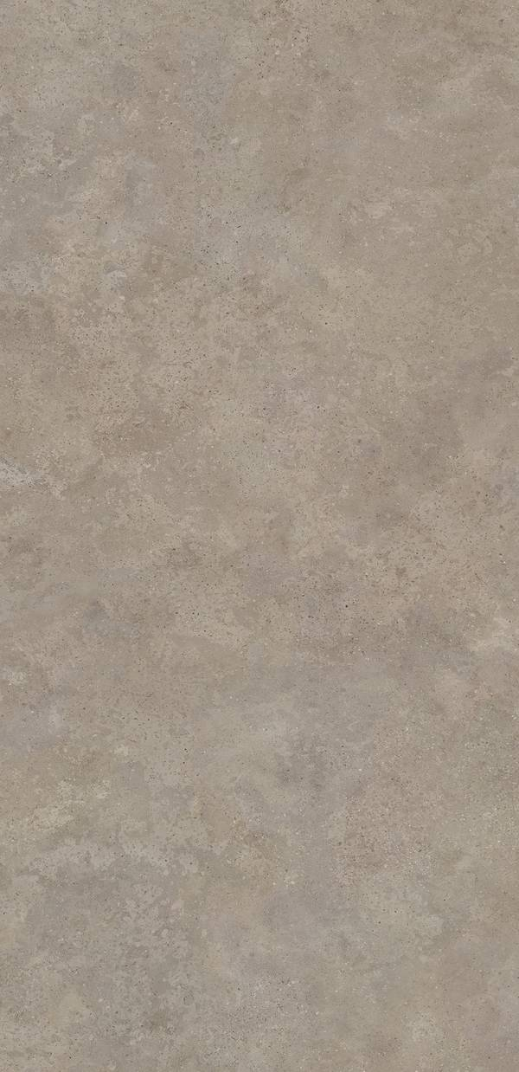
NEOLITH
132
ARTISAN
FINISH
SILK
THICKNESS
6 mm
FORMAT
1600x3200 mm | 63x126 inch
AVAILABLE THICKNESS
6mm | 3.5mm | 3mm
SHEET SIZE
6mm: 1600x3200 | 3mm: 1000x3000
NET WEIGHT
6mm: 14.5 kg/m2 | 3mm: 7.2 kg/m2
SERIE
MARBLE SERIES
REFERENCE
WT1130
MORE VIEWS

Slide 133
NEOLITH
133
ASPEN GREY
FINISH
SILK
THICKNESS
6 mm
FORMAT
1600x3200 mm | 63x126 inch
AVAILABLE THICKNESS
6mm | 3.5mm | 3mm
SHEET SIZE
6mm: 1600x3200 | 3mm: 1000x3000
NET WEIGHT
6mm: 14.5 kg/m2 | 3mm: 7.2 kg/m2
SERIE
MARBLE SERIES
REFERENCE
WT1131
MORE VIEWS

Slide 134
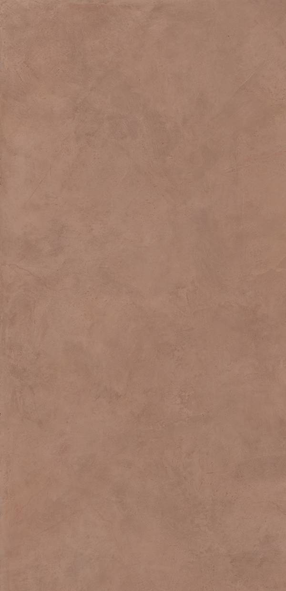
NEOLITH
134
AZAHAR
FINISH
SILK
THICKNESS
6 mm
FORMAT
1600x3200 mm | 63x126 inch
AVAILABLE THICKNESS
6mm | 3.5mm | 3mm
SHEET SIZE
6mm: 1600x3200 | 3mm: 1000x3000
NET WEIGHT
6mm: 14.5 kg/m2 | 3mm: 7.2 kg/m2
SERIE
MARBLE SERIES
REFERENCE
WT1132
MORE VIEWS

Slide 135
NEOLITH
135
AZURE | THE NEW CLASSTONE
FINISH
SILK
THICKNESS
6 mm
FORMAT
1600x3200 mm | 63x126 inch
AVAILABLE THICKNESS
6mm | 3.5mm | 3mm
SHEET SIZE
6mm: 1600x3200 | 3mm: 1000x3000
NET WEIGHT
6mm: 14.5 kg/m2 | 3mm: 7.2 kg/m2
SERIE
MARBLE SERIES
REFERENCE
WT1133
MORE VIEWS

Slide 136
NEOLITH
136
BARRO
FINISH
SILK
THICKNESS
6 mm
FORMAT
1600x3200 mm | 63x126 inch
AVAILABLE THICKNESS
6mm | 3.5mm | 3mm
SHEET SIZE
6mm: 1600x3200 | 3mm: 1000x3000
NET WEIGHT
6mm: 14.5 kg/m2 | 3mm: 7.2 kg/m2
SERIE
MARBLE SERIES
REFERENCE
WT1134
MORE VIEWS

Slide 137
NEOLITH
137
BASALT BLACK
FINISH
SILK
THICKNESS
6 mm
FORMAT
1600x3200 mm | 63x126 inch
AVAILABLE THICKNESS
6mm | 3.5mm | 3mm
SHEET SIZE
6mm: 1600x3200 | 3mm: 1000x3000
NET WEIGHT
6mm: 14.5 kg/m2 | 3mm: 7.2 kg/m2
SERIE
MARBLE SERIES
REFERENCE
WT1135
MORE VIEWS

Slide 138
NEOLITH
138
BASALT GREY
FINISH
SILK
THICKNESS
6 mm
FORMAT
1600x3200 mm | 63x126 inch
AVAILABLE THICKNESS
6mm | 3.5mm | 3mm
SHEET SIZE
6mm: 1600x3200 | 3mm: 1000x3000
NET WEIGHT
6mm: 14.5 kg/m2 | 3mm: 7.2 kg/m2
SERIE
MARBLE SERIES
REFERENCE
WT1136
MORE VIEWS

Slide 139
NEOLITH
139
BETON
FINISH
SILK
THICKNESS
6 mm
FORMAT
1600x3200 mm | 63x126 inch
AVAILABLE THICKNESS
6mm | 3.5mm | 3mm
SHEET SIZE
6mm: 1600x3200 | 3mm: 1000x3000
NET WEIGHT
6mm: 14.5 kg/m2 | 3mm: 7.2 kg/m2
SERIE
MARBLE SERIES
REFERENCE
WT1137
MORE VIEWS

Slide 140
NEOLITH
140
BLACK OBSESSION
FINISH
SILK
THICKNESS
6 mm
FORMAT
1600x3200 mm | 63x126 inch
AVAILABLE THICKNESS
6mm | 3.5mm | 3mm
SHEET SIZE
6mm: 1600x3200 | 3mm: 1000x3000
NET WEIGHT
6mm: 14.5 kg/m2 | 3mm: 7.2 kg/m2
SERIE
MARBLE SERIES
REFERENCE
WT1138
MORE VIEWS

Slide 141
NEOLITH
141
CALACATTA GOLD | THE NEW CLASSTONE
FINISH
POLISHED
THICKNESS
6 mm
FORMAT
1600x3200 mm | 63x126 inch
AVAILABLE THICKNESS
6mm | 3.5mm | 3mm
SHEET SIZE
6mm: 1600x3200 | 3mm: 1000x3000
NET WEIGHT
6mm: 14.5 kg/m2 | 3mm: 7.2 kg/m2
SERIE
MARBLE SERIES
REFERENCE
WT01
MORE VIEWS

Slide 142
NEOLITH
142
CALACATTA LUXE | THE NEW CLASSTONE
FINISH
POLISHED
THICKNESS
6 mm
FORMAT
1600x3200 mm | 63x126 inch
AVAILABLE THICKNESS
6mm | 3.5mm | 3mm
SHEET SIZE
6mm: 1600x3200 | 3mm: 1000x3000
NET WEIGHT
6mm: 14.5 kg/m2 | 3mm: 7.2 kg/m2
SERIE
MARBLE SERIES
REFERENCE
WT01
MORE VIEWS

Slide 143
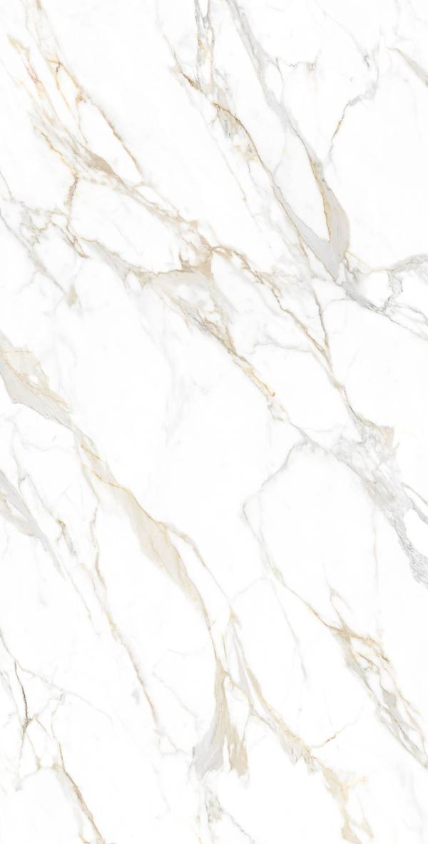
NEOLITH
143
CALACATTA ROMA - THE NEW CLASSTONE
FINISH
POLISHED
THICKNESS
6 mm
FORMAT
1600x3200 mm | 63x126 inch
AVAILABLE THICKNESS
6mm | 3.5mm | 3mm
SHEET SIZE
6mm: 1600x3200 | 3mm: 1000x3000
NET WEIGHT
6mm: 14.5 kg/m2 | 3mm: 7.2 kg/m2
SERIE
MARBLE SERIES
REFERENCE
WT1141
MORE VIEWS

Slide 144
NEOLITH
144
CALACATTA ROYALE | THE NEW CLASSTONE
FINISH
POLISHED
THICKNESS
6 mm
FORMAT
1600x3200 mm | 63x126 inch
AVAILABLE THICKNESS
6mm | 3.5mm | 3mm
SHEET SIZE
6mm: 1600x3200 | 3mm: 1000x3000
NET WEIGHT
6mm: 14.5 kg/m2 | 3mm: 7.2 kg/m2
SERIE
MARBLE SERIES
REFERENCE
WT1142
MORE VIEWS

Slide 145
NEOLITH
145
CALACATTA | THE NEW CLASSTONE
FINISH
POLISHED
THICKNESS
6 mm
FORMAT
1600x3200 mm | 63x126 inch
AVAILABLE THICKNESS
6mm | 3.5mm | 3mm
SHEET SIZE
6mm: 1600x3200 | 3mm: 1000x3000
NET WEIGHT
6mm: 14.5 kg/m2 | 3mm: 7.2 kg/m2
SERIE
MARBLE SERIES
REFERENCE
WT01
MORE VIEWS

Slide 146
NEOLITH
146
CALATORAO | THE NEW CLASSTONE
FINISH
SILK
THICKNESS
6 mm
FORMAT
1600x3200 mm | 63x126 inch
AVAILABLE THICKNESS
6mm | 3.5mm | 3mm
SHEET SIZE
6mm: 1600x3200 | 3mm: 1000x3000
NET WEIGHT
6mm: 14.5 kg/m2 | 3mm: 7.2 kg/m2
SERIE
MARBLE SERIES
REFERENCE
WT1144
MORE VIEWS

Slide 147
NEOLITH
147
CALISTA | THE NEW CLASSTONE
FINISH
SILK
THICKNESS
6 mm
FORMAT
1600x3200 mm | 63x126 inch
AVAILABLE THICKNESS
6mm | 3.5mm | 3mm
SHEET SIZE
6mm: 1600x3200 | 3mm: 1000x3000
NET WEIGHT
6mm: 14.5 kg/m2 | 3mm: 7.2 kg/m2
SERIE
MARBLE SERIES
REFERENCE
WT1145
MORE VIEWS

Slide 148
NEOLITH
148
CEMENT
FINISH
MATTE
THICKNESS
6 mm
FORMAT
1600x3200 mm | 63x126 inch
AVAILABLE THICKNESS
6mm | 3.5mm | 3mm
SHEET SIZE
6mm: 1600x3200 | 3mm: 1000x3000
NET WEIGHT
6mm: 14.5 kg/m2 | 3mm: 7.2 kg/m2
SERIE
MARBLE SERIES
REFERENCE
WT1146
MORE VIEWS

Slide 149
NEOLITH
149
COLORADO DUNES | THE NEW CLASSTONE
FINISH
SILK
THICKNESS
6 mm
FORMAT
1600x3200 mm | 63x126 inch
AVAILABLE THICKNESS
6mm | 3.5mm | 3mm
SHEET SIZE
6mm: 1600x3200 | 3mm: 1000x3000
NET WEIGHT
6mm: 14.5 kg/m2 | 3mm: 7.2 kg/m2
SERIE
MARBLE SERIES
REFERENCE
WT1147
MORE VIEWS

Slide 150
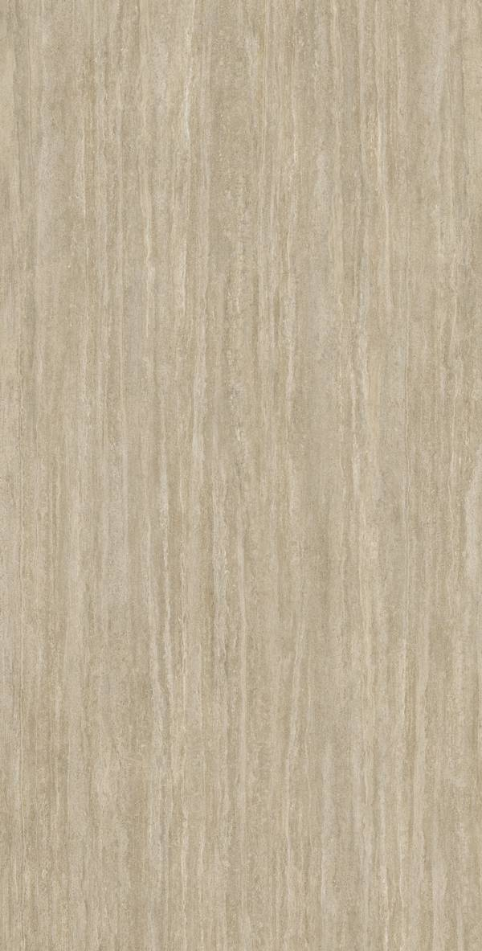
NEOLITH
150
COLOSSEO
FINISH
SILK
THICKNESS
6 mm
FORMAT
1600x3200 mm | 63x126 inch
AVAILABLE THICKNESS
6mm | 3.5mm | 3mm
SHEET SIZE
6mm: 1600x3200 | 3mm: 1000x3000
NET WEIGHT
6mm: 14.5 kg/m2 | 3mm: 7.2 kg/m2
SERIE
MARBLE SERIES
REFERENCE
WT1148
MORE VIEWS

Slide 151
NEOLITH
151
CRÈME
FINISH
SILK
THICKNESS
6 mm
FORMAT
1600x3200 mm | 63x126 inch
AVAILABLE THICKNESS
6mm | 3.5mm | 3mm
SHEET SIZE
6mm: 1600x3200 | 3mm: 1000x3000
NET WEIGHT
6mm: 14.5 kg/m2 | 3mm: 7.2 kg/m2
SERIE
MARBLE SERIES
REFERENCE
WT1149
MORE VIEWS

Slide 152
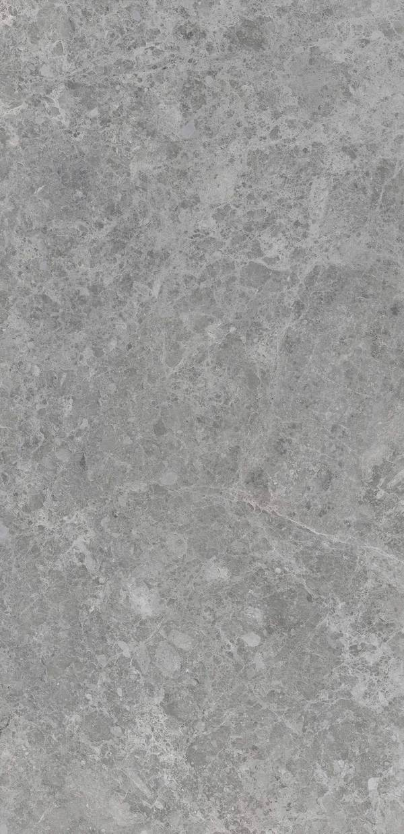
NEOLITH
152
DISCOVER THE FUSION COLLECTION
FINISH
SILK
THICKNESS
6 mm
FORMAT
1600x3200 mm | 63x126 inch
AVAILABLE THICKNESS
6mm | 3.5mm | 3mm
SHEET SIZE
6mm: 1600x3200 | 3mm: 1000x3000
NET WEIGHT
6mm: 14.5 kg/m2 | 3mm: 7.2 kg/m2
SERIE
MARBLE SERIES
REFERENCE
WT1150
MORE VIEWS

Slide 153
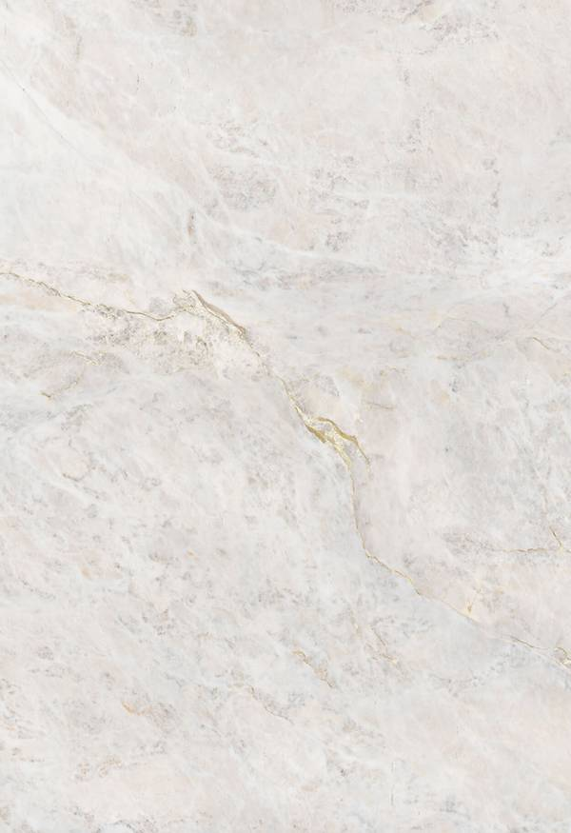
NEOLITH
153
EVEREST SUNRISE
FINISH
SILK
THICKNESS
6 mm
FORMAT
1600x3200 mm | 63x126 inch
AVAILABLE THICKNESS
6mm | 3.5mm | 3mm
SHEET SIZE
6mm: 1600x3200 | 3mm: 1000x3000
NET WEIGHT
6mm: 14.5 kg/m2 | 3mm: 7.2 kg/m2
SERIE
MARBLE SERIES
REFERENCE
WT1151
MORE VIEWS

Slide 154
NEOLITH
154
HIMALAYA CRYSTAL | THE NEW CLASSTONE
FINISH
SILK
THICKNESS
6 mm
FORMAT
1600x3200 mm | 63x126 inch
AVAILABLE THICKNESS
6mm | 3.5mm | 3mm
SHEET SIZE
6mm: 1600x3200 | 3mm: 1000x3000
NET WEIGHT
6mm: 14.5 kg/m2 | 3mm: 7.2 kg/m2
SERIE
MARBLE SERIES
REFERENCE
WT1152
MORE VIEWS

Slide 155
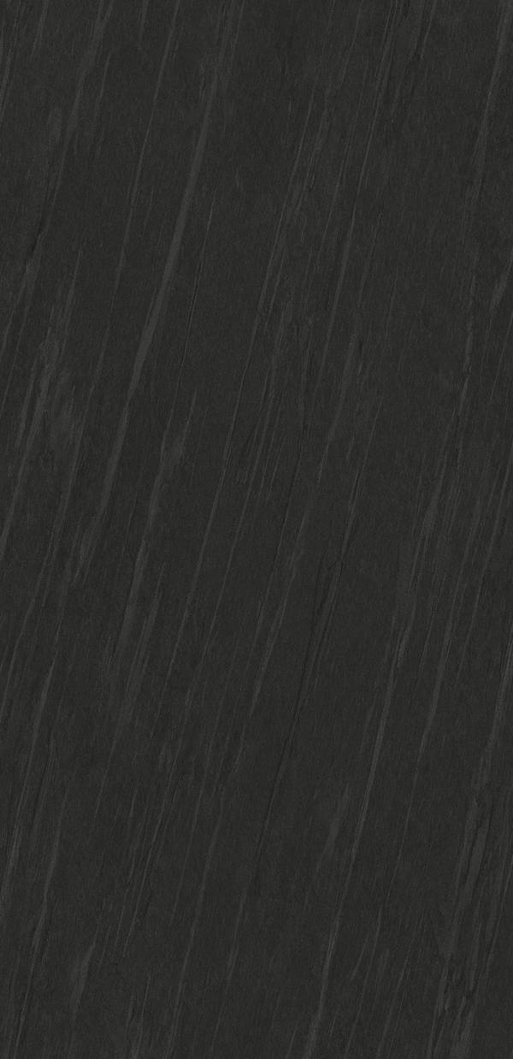
NEOLITH
155
IGNEA
FINISH
SILK
THICKNESS
6 mm
FORMAT
1600x3200 mm | 63x126 inch
AVAILABLE THICKNESS
6mm | 3.5mm | 3mm
SHEET SIZE
6mm: 1600x3200 | 3mm: 1000x3000
NET WEIGHT
6mm: 14.5 kg/m2 | 3mm: 7.2 kg/m2
SERIE
MARBLE SERIES
REFERENCE
WT1153
MORE VIEWS

Slide 156
NEOLITH
156
KRATER
FINISH
SILK
THICKNESS
6 mm
FORMAT
1600x3200 mm | 63x126 inch
AVAILABLE THICKNESS
6mm | 3.5mm | 3mm
SHEET SIZE
6mm: 1600x3200 | 3mm: 1000x3000
NET WEIGHT
6mm: 14.5 kg/m2 | 3mm: 7.2 kg/m2
SERIE
MARBLE SERIES
REFERENCE
WT1154
MORE VIEWS

Slide 157
NEOLITH
157
LAYLA | THE NEW CLASSTONE
FINISH
SILK
THICKNESS
6 mm
FORMAT
1600x3200 mm | 63x126 inch
AVAILABLE THICKNESS
6mm | 3.5mm | 3mm
SHEET SIZE
6mm: 1600x3200 | 3mm: 1000x3000
NET WEIGHT
6mm: 14.5 kg/m2 | 3mm: 7.2 kg/m2
SERIE
MARBLE SERIES
REFERENCE
WT1155
MORE VIEWS

Slide 158
NEOLITH
158
MAMBA
FINISH
SILK
THICKNESS
6 mm
FORMAT
1600x3200 mm | 63x126 inch
AVAILABLE THICKNESS
6mm | 3.5mm | 3mm
SHEET SIZE
6mm: 1600x3200 | 3mm: 1000x3000
NET WEIGHT
6mm: 14.5 kg/m2 | 3mm: 7.2 kg/m2
SERIE
MARBLE SERIES
REFERENCE
WT1156
MORE VIEWS

Slide 159
NEOLITH
159
MODELO ESTATUARIO | THE NEW CLASSTONE
FINISH
POLISHED
THICKNESS
6 mm
FORMAT
1600x3200 mm | 63x126 inch
AVAILABLE THICKNESS
6mm | 3.5mm | 3mm
SHEET SIZE
6mm: 1600x3200 | 3mm: 1000x3000
NET WEIGHT
6mm: 14.5 kg/m2 | 3mm: 7.2 kg/m2
SERIE
MARBLE SERIES
REFERENCE
WT01
MORE VIEWS

Slide 160
NEOLITH
160
MONT BLANC | THE NEW CLASSTONE
FINISH
SILK
THICKNESS
6 mm
FORMAT
1600x3200 mm | 63x126 inch
AVAILABLE THICKNESS
6mm | 3.5mm | 3mm
SHEET SIZE
6mm: 1600x3200 | 3mm: 1000x3000
NET WEIGHT
6mm: 14.5 kg/m2 | 3mm: 7.2 kg/m2
SERIE
MARBLE SERIES
REFERENCE
WT1158
MORE VIEWS

Slide 161
NEOLITH
161
NERO ZIMBABWE
FINISH
SILK
THICKNESS
6 mm
FORMAT
1600x3200 mm | 63x126 inch
AVAILABLE THICKNESS
6mm | 3.5mm | 3mm
SHEET SIZE
6mm: 1600x3200 | 3mm: 1000x3000
NET WEIGHT
6mm: 14.5 kg/m2 | 3mm: 7.2 kg/m2
SERIE
MARBLE SERIES
REFERENCE
WT1159
MORE VIEWS

Slide 162
NEOLITH
162
NEW YORK - NEW YORK
FINISH
SILK
THICKNESS
6 mm
FORMAT
1600x3200 mm | 63x126 inch
AVAILABLE THICKNESS
6mm | 3.5mm | 3mm
SHEET SIZE
6mm: 1600x3200 | 3mm: 1000x3000
NET WEIGHT
6mm: 14.5 kg/m2 | 3mm: 7.2 kg/m2
SERIE
MARBLE SERIES
REFERENCE
WT1160
MORE VIEWS

Slide 163
NEOLITH
163
NIAGARA | THE NEW CLASSTONE
FINISH
SILK
THICKNESS
6 mm
FORMAT
1600x3200 mm | 63x126 inch
AVAILABLE THICKNESS
6mm | 3.5mm | 3mm
SHEET SIZE
6mm: 1600x3200 | 3mm: 1000x3000
NET WEIGHT
6mm: 14.5 kg/m2 | 3mm: 7.2 kg/m2
SERIE
MARBLE SERIES
REFERENCE
WT1161
MORE VIEWS

Slide 164

NEOLITH
164
OBSIDIAN
FINISH
SILK
THICKNESS
6 mm
FORMAT
1600x3200 mm | 63x126 inch
AVAILABLE THICKNESS
6mm | 3.5mm | 3mm
SHEET SIZE
6mm: 1600x3200 | 3mm: 1000x3000
NET WEIGHT
6mm: 14.5 kg/m2 | 3mm: 7.2 kg/m2
SERIE
MARBLE SERIES
REFERENCE
WT1162
MORE VIEWS

Slide 165
NEOLITH
165
PIETRA DI LUNA
FINISH
SILK
THICKNESS
6 mm
FORMAT
1600x3200 mm | 63x126 inch
AVAILABLE THICKNESS
6mm | 3.5mm | 3mm
SHEET SIZE
6mm: 1600x3200 | 3mm: 1000x3000
NET WEIGHT
6mm: 14.5 kg/m2 | 3mm: 7.2 kg/m2
SERIE
MARBLE SERIES
REFERENCE
WT1163
MORE VIEWS

Slide 166
NEOLITH
166
PIETRA DI OSSO
FINISH
SILK
THICKNESS
6 mm
FORMAT
1600x3200 mm | 63x126 inch
AVAILABLE THICKNESS
6mm | 3.5mm | 3mm
SHEET SIZE
6mm: 1600x3200 | 3mm: 1000x3000
NET WEIGHT
6mm: 14.5 kg/m2 | 3mm: 7.2 kg/m2
SERIE
MARBLE SERIES
REFERENCE
WT1164
MORE VIEWS

Slide 167
NEOLITH
167
PIETRA DI PIOMBO
FINISH
SILK
THICKNESS
6 mm
FORMAT
1600x3200 mm | 63x126 inch
AVAILABLE THICKNESS
6mm | 3.5mm | 3mm
SHEET SIZE
6mm: 1600x3200 | 3mm: 1000x3000
NET WEIGHT
6mm: 14.5 kg/m2 | 3mm: 7.2 kg/m2
SERIE
MARBLE SERIES
REFERENCE
WT1165
MORE VIEWS

Slide 168
NEOLITH
168
PIETRA GREY
FINISH
SILK
THICKNESS
6 mm
FORMAT
1600x3200 mm | 63x126 inch
AVAILABLE THICKNESS
6mm | 3.5mm | 3mm
SHEET SIZE
6mm: 1600x3200 | 3mm: 1000x3000
NET WEIGHT
6mm: 14.5 kg/m2 | 3mm: 7.2 kg/m2
SERIE
MARBLE SERIES
REFERENCE
WT1166
MORE VIEWS

Slide 169
NEOLITH
169
PULPIS | THE NEW CLASSTONE
FINISH
SILK
THICKNESS
6 mm
FORMAT
1600x3200 mm | 63x126 inch
AVAILABLE THICKNESS
6mm | 3.5mm | 3mm
SHEET SIZE
6mm: 1600x3200 | 3mm: 1000x3000
NET WEIGHT
6mm: 14.5 kg/m2 | 3mm: 7.2 kg/m2
SERIE
MARBLE SERIES
REFERENCE
WT1167
MORE VIEWS

Slide 170
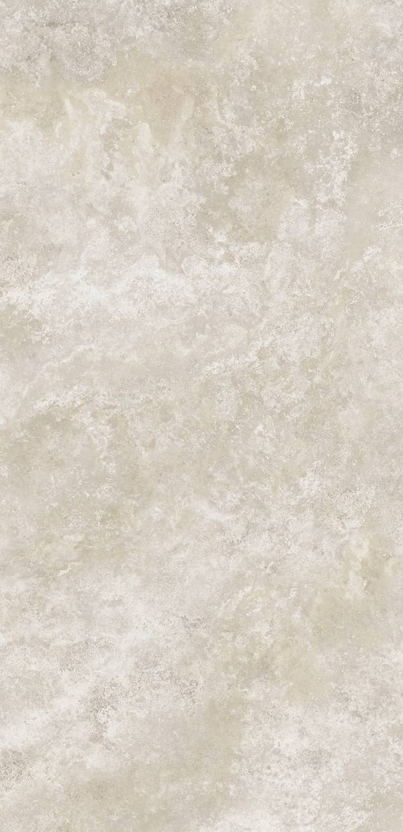
NEOLITH
170
RAPOLANO
FINISH
SILK
THICKNESS
6 mm
FORMAT
1600x3200 mm | 63x126 inch
AVAILABLE THICKNESS
6mm | 3.5mm | 3mm
SHEET SIZE
6mm: 1600x3200 | 3mm: 1000x3000
NET WEIGHT
6mm: 14.5 kg/m2 | 3mm: 7.2 kg/m2
SERIE
MARBLE SERIES
REFERENCE
WT1168
MORE VIEWS

Slide 171
NEOLITH
171
RETROSTONE
FINISH
SILK
THICKNESS
6 mm
FORMAT
1600x3200 mm | 63x126 inch
AVAILABLE THICKNESS
6mm | 3.5mm | 3mm
SHEET SIZE
6mm: 1600x3200 | 3mm: 1000x3000
NET WEIGHT
6mm: 14.5 kg/m2 | 3mm: 7.2 kg/m2
SERIE
MARBLE SERIES
REFERENCE
WT1169
MORE VIEWS

Slide 172
NEOLITH
172
SAN SIMONE| THE NEW CLASSTONE
FINISH
SILK
THICKNESS
6 mm
FORMAT
1600x3200 mm | 63x126 inch
AVAILABLE THICKNESS
6mm | 3.5mm | 3mm
SHEET SIZE
6mm: 1600x3200 | 3mm: 1000x3000
NET WEIGHT
6mm: 14.5 kg/m2 | 3mm: 7.2 kg/m2
SERIE
MARBLE SERIES
REFERENCE
WT1170
MORE VIEWS

Slide 173
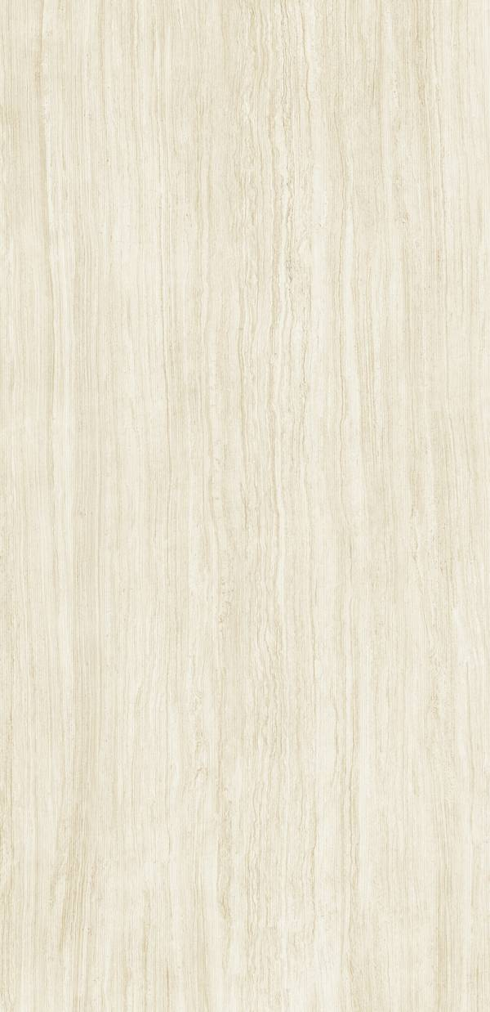
NEOLITH
173
SERPEGGIANTE
FINISH
SILK
THICKNESS
6 mm
FORMAT
1600x3200 mm | 63x126 inch
AVAILABLE THICKNESS
6mm | 3.5mm | 3mm
SHEET SIZE
6mm: 1600x3200 | 3mm: 1000x3000
NET WEIGHT
6mm: 14.5 kg/m2 | 3mm: 7.2 kg/m2
SERIE
MARBLE SERIES
REFERENCE
WT1171
MORE VIEWS

Slide 174
NEOLITH
174
SHILIN
FINISH
SILK
THICKNESS
6 mm
FORMAT
1600x3200 mm | 63x126 inch
AVAILABLE THICKNESS
6mm | 3.5mm | 3mm
SHEET SIZE
6mm: 1600x3200 | 3mm: 1000x3000
NET WEIGHT
6mm: 14.5 kg/m2 | 3mm: 7.2 kg/m2
SERIE
MARBLE SERIES
REFERENCE
WT1172
MORE VIEWS

Slide 175
NEOLITH
175
SRATA ARGENTUM | THE NEW CLASSTONE
FINISH
SILK
THICKNESS
6 mm
FORMAT
1600x3200 mm | 63x126 inch
AVAILABLE THICKNESS
6mm | 3.5mm | 3mm
SHEET SIZE
6mm: 1600x3200 | 3mm: 1000x3000
NET WEIGHT
6mm: 14.5 kg/m2 | 3mm: 7.2 kg/m2
SERIE
MARBLE SERIES
REFERENCE
WT1173
MORE VIEWS

Slide 176
NEOLITH
176
TAJ MAHAL | THE NEW CLASSTONE
FINISH
SILK
THICKNESS
6 mm
FORMAT
1600x3200 mm | 63x126 inch
AVAILABLE THICKNESS
6mm | 3.5mm | 3mm
SHEET SIZE
6mm: 1600x3200 | 3mm: 1000x3000
NET WEIGHT
6mm: 14.5 kg/m2 | 3mm: 7.2 kg/m2
SERIE
MARBLE SERIES
REFERENCE
WT1174
MORE VIEWS

Slide 177
NEOLITH
177
TERRAZO CEPPO
FINISH
SILK
THICKNESS
6 mm
FORMAT
1600x3200 mm | 63x126 inch
AVAILABLE THICKNESS
6mm | 3.5mm | 3mm
SHEET SIZE
6mm: 1600x3200 | 3mm: 1000x3000
NET WEIGHT
6mm: 14.5 kg/m2 | 3mm: 7.2 kg/m2
SERIE
MARBLE SERIES
REFERENCE
WT1175
MORE VIEWS

Slide 178
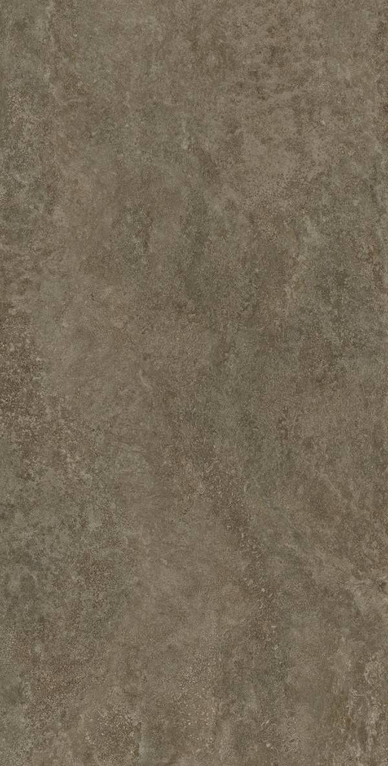
NEOLITH
178
TOSCANO
FINISH
SILK
THICKNESS
6 mm
FORMAT
1600x3200 mm | 63x126 inch
AVAILABLE THICKNESS
6mm | 3.5mm | 3mm
SHEET SIZE
6mm: 1600x3200 | 3mm: 1000x3000
NET WEIGHT
6mm: 14.5 kg/m2 | 3mm: 7.2 kg/m2
SERIE
MARBLE SERIES
REFERENCE
WT1176
MORE VIEWS

Slide 179
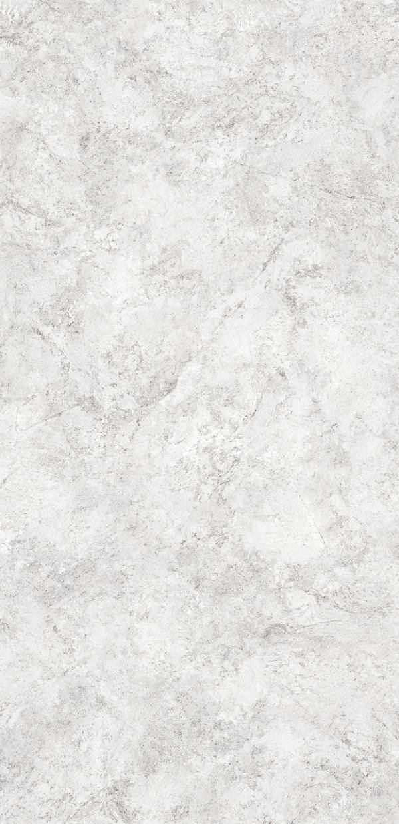
NEOLITH
179
WHITESANDS | THE NEW CLASSTONE
FINISH
SILK
THICKNESS
6 mm
FORMAT
1600x3200 mm | 63x126 inch
AVAILABLE THICKNESS
6mm | 3.5mm | 3mm
SHEET SIZE
6mm: 1600x3200 | 3mm: 1000x3000
NET WEIGHT
6mm: 14.5 kg/m2 | 3mm: 7.2 kg/m2
SERIE
MARBLE SERIES
REFERENCE
WT1177
MORE VIEWS

Slide 180
NEOLITH
180
WULONG
FINISH
SILK
THICKNESS
6 mm
FORMAT
1600x3200 mm | 63x126 inch
AVAILABLE THICKNESS
6mm | 3.5mm | 3mm
SHEET SIZE
6mm: 1600x3200 | 3mm: 1000x3000
NET WEIGHT
6mm: 14.5 kg/m2 | 3mm: 7.2 kg/m2
SERIE
MARBLE SERIES
REFERENCE
WT1178
MORE VIEWS

Slide 181
NEOLITH
181
ZAHA STONE
FINISH
SILK
THICKNESS
6 mm
FORMAT
1600x3200 mm | 63x126 inch
AVAILABLE THICKNESS
6mm | 3.5mm | 3mm
SHEET SIZE
6mm: 1600x3200 | 3mm: 1000x3000
NET WEIGHT
6mm: 14.5 kg/m2 | 3mm: 7.2 kg/m2
SERIE
MARBLE SERIES
REFERENCE
WT1179
MORE VIEWS

Slide 182
NEOLITH
182
IRON COPPER | IRON
FINISH
HONED
THICKNESS
6 mm
FORMAT
1600x3200 mm | 63x126 inch
AVAILABLE THICKNESS
6mm | 3.5mm | 3mm
SHEET SIZE
6mm: 1600x3200 | 3mm: 1000x3000
NET WEIGHT
6mm: 14.5 kg/m2 | 3mm: 7.2 kg/m2
SERIE
METAL SERIES
REFERENCE
WT1180
MORE VIEWS

Slide 183
NEOLITH
183
IRON CORTEN | IRON
FINISH
HONED
THICKNESS
6 mm
FORMAT
1600x3200 mm | 63x126 inch
AVAILABLE THICKNESS
6mm | 3.5mm | 3mm
SHEET SIZE
6mm: 1600x3200 | 3mm: 1000x3000
NET WEIGHT
6mm: 14.5 kg/m2 | 3mm: 7.2 kg/m2
SERIE
METAL SERIES
REFERENCE
WT1181
MORE VIEWS

Slide 184
NEOLITH
184
IRON FROST | IRON
FINISH
HONED
THICKNESS
6 mm
FORMAT
1600x3200 mm | 63x126 inch
AVAILABLE THICKNESS
6mm | 3.5mm | 3mm
SHEET SIZE
6mm: 1600x3200 | 3mm: 1000x3000
NET WEIGHT
6mm: 14.5 kg/m2 | 3mm: 7.2 kg/m2
SERIE
METAL SERIES
REFERENCE
WT1182
MORE VIEWS

Slide 185
NEOLITH
185
IRON GREY | IRON
FINISH
HONED
THICKNESS
6 mm
FORMAT
1600x3200 mm | 63x126 inch
AVAILABLE THICKNESS
6mm | 3.5mm | 3mm
SHEET SIZE
6mm: 1600x3200 | 3mm: 1000x3000
NET WEIGHT
6mm: 14.5 kg/m2 | 3mm: 7.2 kg/m2
SERIE
METAL SERIES
REFERENCE
WT1183
MORE VIEWS

Slide 186
NEOLITH
186
METROPOLITAN | STEEL
FINISH
HONED
THICKNESS
6 mm
FORMAT
1600x3200 mm | 63x126 inch
AVAILABLE THICKNESS
6mm | 3.5mm | 3mm
SHEET SIZE
6mm: 1600x3200 | 3mm: 1000x3000
NET WEIGHT
6mm: 14.5 kg/m2 | 3mm: 7.2 kg/m2
SERIE
METAL SERIES
REFERENCE
WT1184
MORE VIEWS

Slide 187
NEOLITH
187
ARCTIC WHITE | COLORFEEL
FINISH
SILK
THICKNESS
6 mm
FORMAT
1600x3200 mm | 63x126 inch
AVAILABLE THICKNESS
6mm | 3.5mm | 3mm
SHEET SIZE
6mm: 1600x3200 | 3mm: 1000x3000
NET WEIGHT
6mm: 14.5 kg/m2 | 3mm: 7.2 kg/m2
SERIE
SOLID COLOR
REFERENCE
WT1185
MORE VIEWS

Slide 188
NEOLITH
188
JUST WHITE | COLORFEEL
FINISH
SILK
THICKNESS
6 mm
FORMAT
1600x3200 mm | 63x126 inch
AVAILABLE THICKNESS
6mm | 3.5mm | 3mm
SHEET SIZE
6mm: 1600x3200 | 3mm: 1000x3000
NET WEIGHT
6mm: 14.5 kg/m2 | 3mm: 7.2 kg/m2
SERIE
SOLID COLOR
REFERENCE
WT1186
MORE VIEWS

Slide 189
NEOLITH
189
LUX | COLORFEEL
FINISH
POLISHED
THICKNESS
6 mm
FORMAT
1600x3200 mm | 63x126 inch
AVAILABLE THICKNESS
6mm | 3.5mm | 3mm
SHEET SIZE
6mm: 1600x3200 | 3mm: 1000x3000
NET WEIGHT
6mm: 14.5 kg/m2 | 3mm: 7.2 kg/m2
SERIE
SOLID COLOR
REFERENCE
WT1187
MORE VIEWS

Slide 190
NEOLITH
190
NERO | COLORFEEL
FINISH
SILK
THICKNESS
6 mm
FORMAT
1600x3200 mm | 63x126 inch
AVAILABLE THICKNESS
6mm | 3.5mm | 3mm
SHEET SIZE
6mm: 1600x3200 | 3mm: 1000x3000
NET WEIGHT
6mm: 14.5 kg/m2 | 3mm: 7.2 kg/m2
SERIE
SOLID COLOR
REFERENCE
WT1188
MORE VIEWS

Slide 191

NEOLITH
191
NIVOLA | COLORFEEL
FINISH
SILK
THICKNESS
6 mm
FORMAT
1600x3200 mm | 63x126 inch
AVAILABLE THICKNESS
6mm | 3.5mm | 3mm
SHEET SIZE
6mm: 1600x3200 | 3mm: 1000x3000
NET WEIGHT
6mm: 14.5 kg/m2 | 3mm: 7.2 kg/m2
SERIE
SOLID COLOR
REFERENCE
WT1189
MORE VIEWS

Slide 192
TECHLAM
192
ALHAMBRA
FINISH
SILK
THICKNESS
20 mm
FORMAT
1600x3200 mm | 63x126 inch
AVAILABLE THICKNESS
6mm | 3.5mm | 3mm
SHEET SIZE
6mm: 1600x3200 | 3mm: 1000x3000
NET WEIGHT
6mm: 14.5 kg/m2 | 3mm: 7.2 kg/m2
SERIE
TECHLAM COLLECTION
REFERENCE
WT1190
MORE VIEWS

Slide 193
TECHLAM
193
AMAZONIA
FINISH
SILK
THICKNESS
20 mm
FORMAT
1600x3200 mm | 63x126 inch
AVAILABLE THICKNESS
6mm | 3.5mm | 3mm
SHEET SIZE
6mm: 1600x3200 | 3mm: 1000x3000
NET WEIGHT
6mm: 14.5 kg/m2 | 3mm: 7.2 kg/m2
SERIE
TECHLAM COLLECTION
REFERENCE
WT1191
MORE VIEWS

Slide 194
TECHLAM
194
BELLAGIO
FINISH
POLISHED
THICKNESS
20 mm
FORMAT
1600x3200 mm | 63x126 inch
AVAILABLE THICKNESS
6mm | 3.5mm | 3mm
SHEET SIZE
6mm: 1600x3200 | 3mm: 1000x3000
NET WEIGHT
6mm: 14.5 kg/m2 | 3mm: 7.2 kg/m2
SERIE
TECHLAM COLLECTION
REFERENCE
WT1192
MORE VIEWS

Slide 195
TECHLAM
195
BIANCO LASA
FINISH
POLISHED
THICKNESS
6 mm
FORMAT
1600x3200 mm | 63x126 inch
AVAILABLE THICKNESS
6mm | 3.5mm | 3mm
SHEET SIZE
6mm: 1600x3200 | 3mm: 1000x3000
NET WEIGHT
6mm: 14.5 kg/m2 | 3mm: 7.2 kg/m2
SERIE
TECHLAM COLLECTION
REFERENCE
WT1193
MORE VIEWS

Slide 196

TECHLAM
196
BLAZE DARK
FINISH
POLISHED
THICKNESS
6 mm
FORMAT
1600x3200 mm | 63x126 inch
AVAILABLE THICKNESS
6mm | 3.5mm | 3mm
SHEET SIZE
6mm: 1600x3200 | 3mm: 1000x3000
NET WEIGHT
6mm: 14.5 kg/m2 | 3mm: 7.2 kg/m2
SERIE
TECHLAM COLLECTION
REFERENCE
WT1194
MORE VIEWS

Slide 197
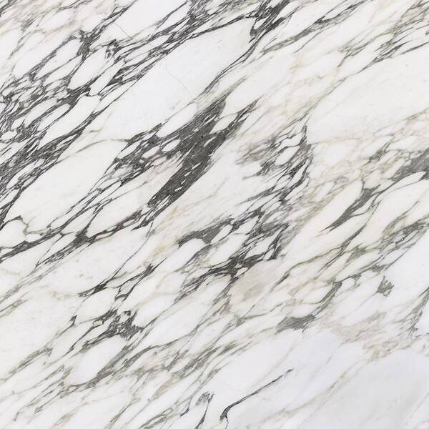
TECHLAM
197
BLAZE SNOW
FINISH
SILK
THICKNESS
6 mm
FORMAT
1600x3200 mm | 63x126 inch
AVAILABLE THICKNESS
6mm | 3.5mm | 3mm
SHEET SIZE
6mm: 1600x3200 | 3mm: 1000x3000
NET WEIGHT
6mm: 14.5 kg/m2 | 3mm: 7.2 kg/m2
SERIE
TECHLAM COLLECTION
REFERENCE
WT1195
MORE VIEWS

Slide 198
TECHLAM
198
BLOOMCORE
FINISH
SILK
THICKNESS
6 mm
FORMAT
1600x3200 mm | 63x126 inch
AVAILABLE THICKNESS
6mm | 3.5mm | 3mm
SHEET SIZE
6mm: 1600x3200 | 3mm: 1000x3000
NET WEIGHT
6mm: 14.5 kg/m2 | 3mm: 7.2 kg/m2
SERIE
TECHLAM COLLECTION
REFERENCE
WT1196
MORE VIEWS

Slide 199

TECHLAM
199
BRECCIA BROWN
FINISH
SILK
THICKNESS
20 mm
FORMAT
1600x3200 mm | 63x126 inch
AVAILABLE THICKNESS
6mm | 3.5mm | 3mm
SHEET SIZE
6mm: 1600x3200 | 3mm: 1000x3000
NET WEIGHT
6mm: 14.5 kg/m2 | 3mm: 7.2 kg/m2
SERIE
TECHLAM COLLECTION
REFERENCE
WT1197
MORE VIEWS

Slide 200
TECHLAM
200
CALACATTA WHITE
FINISH
POLISHED
THICKNESS
20 mm
FORMAT
1600x3200 mm | 63x126 inch
AVAILABLE THICKNESS
6mm | 3.5mm | 3mm
SHEET SIZE
6mm: 1600x3200 | 3mm: 1000x3000
NET WEIGHT
6mm: 14.5 kg/m2 | 3mm: 7.2 kg/m2
SERIE
TECHLAM COLLECTION
REFERENCE
WT1198
MORE VIEWS

Slide 201

TECHLAM
201
COLOSSAL CREAM
FINISH
POLISHED
THICKNESS
20 mm
FORMAT
1600x3200 mm | 63x126 inch
AVAILABLE THICKNESS
6mm | 3.5mm | 3mm
SHEET SIZE
6mm: 1600x3200 | 3mm: 1000x3000
NET WEIGHT
6mm: 14.5 kg/m2 | 3mm: 7.2 kg/m2
SERIE
TECHLAM COLLECTION
REFERENCE
WT1199
MORE VIEWS

Slide 202
TECHLAM
202
CONCERTO
FINISH
POLISHED
THICKNESS
20 mm
FORMAT
1600x3200 mm | 63x126 inch
AVAILABLE THICKNESS
6mm | 3.5mm | 3mm
SHEET SIZE
6mm: 1600x3200 | 3mm: 1000x3000
NET WEIGHT
6mm: 14.5 kg/m2 | 3mm: 7.2 kg/m2
SERIE
TECHLAM COLLECTION
REFERENCE
WT1200
MORE VIEWS

Slide 203
TECHLAM
203
CORALINA
FINISH
BUSH-HAMMERED
THICKNESS
6 mm
FORMAT
1600x3200 mm | 63x126 inch
AVAILABLE THICKNESS
6mm | 3.5mm | 3mm
SHEET SIZE
6mm: 1600x3200 | 3mm: 1000x3000
NET WEIGHT
6mm: 14.5 kg/m2 | 3mm: 7.2 kg/m2
SERIE
TECHLAM COLLECTION
REFERENCE
WT1201
MORE VIEWS

Slide 204
TECHLAM
204
COSMOPOLITAN BLACK LEVANTINA
FINISH
SILK
THICKNESS
6 mm
FORMAT
1600x3200 mm | 63x126 inch
AVAILABLE THICKNESS
6mm | 3.5mm | 3mm
SHEET SIZE
6mm: 1600x3200 | 3mm: 1000x3000
NET WEIGHT
6mm: 14.5 kg/m2 | 3mm: 7.2 kg/m2
SERIE
TECHLAM COLLECTION
REFERENCE
WT1202
MORE VIEWS

Slide 205
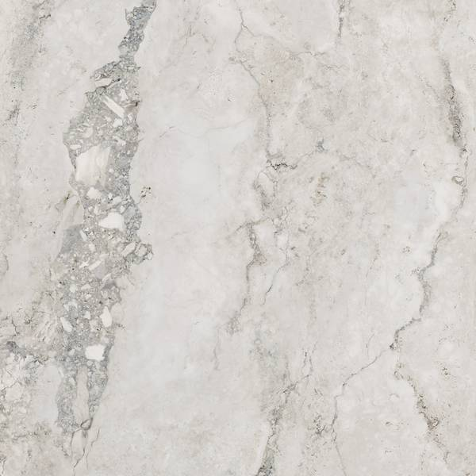
TECHLAM
205
DELTA
FINISH
SILK
THICKNESS
20 mm
FORMAT
1600x3200 mm | 63x126 inch
AVAILABLE THICKNESS
6mm | 3.5mm | 3mm
SHEET SIZE
6mm: 1600x3200 | 3mm: 1000x3000
NET WEIGHT
6mm: 14.5 kg/m2 | 3mm: 7.2 kg/m2
SERIE
TECHLAM COLLECTION
REFERENCE
WT1203
MORE VIEWS

Slide 206
TECHLAM
206
ESSENTIAL GOLD LEVANTINA
FINISH
POLISHED
THICKNESS
20 mm
FORMAT
1600x3200 mm | 63x126 inch
AVAILABLE THICKNESS
6mm | 3.5mm | 3mm
SHEET SIZE
6mm: 1600x3200 | 3mm: 1000x3000
NET WEIGHT
6mm: 14.5 kg/m2 | 3mm: 7.2 kg/m2
SERIE
TECHLAM COLLECTION
REFERENCE
WT1204
MORE VIEWS

Slide 207
TECHLAM
207
FEROX
FINISH
POLISHED
THICKNESS
6 mm
FORMAT
1600x3200 mm | 63x126 inch
AVAILABLE THICKNESS
6mm | 3.5mm | 3mm
SHEET SIZE
6mm: 1600x3200 | 3mm: 1000x3000
NET WEIGHT
6mm: 14.5 kg/m2 | 3mm: 7.2 kg/m2
SERIE
TECHLAM COLLECTION
REFERENCE
WT1205
MORE VIEWS

Slide 208
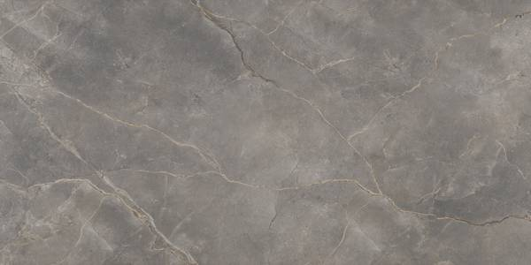
TECHLAM
208
FIOR DI BOSCO
FINISH
MATTE
THICKNESS
20 mm
FORMAT
1600x3200 mm | 63x126 inch
AVAILABLE THICKNESS
6mm | 3.5mm | 3mm
SHEET SIZE
6mm: 1600x3200 | 3mm: 1000x3000
NET WEIGHT
6mm: 14.5 kg/m2 | 3mm: 7.2 kg/m2
SERIE
TECHLAM COLLECTION
REFERENCE
WT1206
MORE VIEWS

Slide 209
TECHLAM
209
HYDRA ARGEN
FINISH
SILK
THICKNESS
6 mm
FORMAT
1600x3200 mm | 63x126 inch
AVAILABLE THICKNESS
6mm | 3.5mm | 3mm
SHEET SIZE
6mm: 1600x3200 | 3mm: 1000x3000
NET WEIGHT
6mm: 14.5 kg/m2 | 3mm: 7.2 kg/m2
SERIE
TECHLAM COLLECTION
REFERENCE
WT1207
MORE VIEWS

Slide 210
TECHLAM
210
HYDRA BEIGE
FINISH
SATIN
THICKNESS
6 mm
FORMAT
1600x3200 mm | 63x126 inch
AVAILABLE THICKNESS
6mm | 3.5mm | 3mm
SHEET SIZE
6mm: 1600x3200 | 3mm: 1000x3000
NET WEIGHT
6mm: 14.5 kg/m2 | 3mm: 7.2 kg/m2
SERIE
TECHLAM COLLECTION
REFERENCE
WT1208
MORE VIEWS

Slide 211
TECHLAM
211
KALOS BIANCO
FINISH
POLISHED
THICKNESS
20 mm
FORMAT
1600x3200 mm | 63x126 inch
AVAILABLE THICKNESS
6mm | 3.5mm | 3mm
SHEET SIZE
6mm: 1600x3200 | 3mm: 1000x3000
NET WEIGHT
6mm: 14.5 kg/m2 | 3mm: 7.2 kg/m2
SERIE
TECHLAM COLLECTION
REFERENCE
WT1209
MORE VIEWS

Slide 212
TECHLAM
212
LIMESTONE
FINISH
MATTE
THICKNESS
5 mm
FORMAT
1600x3200 mm | 63x126 inch
AVAILABLE THICKNESS
6mm | 3.5mm | 3mm
SHEET SIZE
6mm: 1600x3200 | 3mm: 1000x3000
NET WEIGHT
6mm: 14.5 kg/m2 | 3mm: 7.2 kg/m2
SERIE
TECHLAM COLLECTION
REFERENCE
WT1210
MORE VIEWS

Slide 213
TECHLAM
213
MACCHIA GOLD
FINISH
POLISHED
THICKNESS
20 mm
FORMAT
1600x3200 mm | 63x126 inch
AVAILABLE THICKNESS
6mm | 3.5mm | 3mm
SHEET SIZE
6mm: 1600x3200 | 3mm: 1000x3000
NET WEIGHT
6mm: 14.5 kg/m2 | 3mm: 7.2 kg/m2
SERIE
TECHLAM COLLECTION
REFERENCE
WT1211
MORE VIEWS

Slide 214
TECHLAM
214
MARVEL GOLD
FINISH
POLISHED
THICKNESS
20 mm
FORMAT
1600x3200 mm | 63x126 inch
AVAILABLE THICKNESS
6mm | 3.5mm | 3mm
SHEET SIZE
6mm: 1600x3200 | 3mm: 1000x3000
NET WEIGHT
6mm: 14.5 kg/m2 | 3mm: 7.2 kg/m2
SERIE
TECHLAM COLLECTION
REFERENCE
WT1212
MORE VIEWS

Slide 215
TECHLAM
215
OPIUM BLACK
FINISH
SILK
THICKNESS
6 mm
FORMAT
1600x3200 mm | 63x126 inch
AVAILABLE THICKNESS
6mm | 3.5mm | 3mm
SHEET SIZE
6mm: 1600x3200 | 3mm: 1000x3000
NET WEIGHT
6mm: 14.5 kg/m2 | 3mm: 7.2 kg/m2
SERIE
TECHLAM COLLECTION
REFERENCE
WT1213
MORE VIEWS

Slide 216
TECHLAM
216
PIERRE BLEUE
FINISH
BUSH-HAMMERED
THICKNESS
5 mm
FORMAT
1600x3200 mm | 63x126 inch
AVAILABLE THICKNESS
6mm | 3.5mm | 3mm
SHEET SIZE
6mm: 1600x3200 | 3mm: 1000x3000
NET WEIGHT
6mm: 14.5 kg/m2 | 3mm: 7.2 kg/m2
SERIE
TECHLAM COLLECTION
REFERENCE
WT1214
MORE VIEWS

Slide 217
TECHLAM
217
PURE BONE
FINISH
SILK
THICKNESS
6 mm
FORMAT
1600x3200 mm | 63x126 inch
AVAILABLE THICKNESS
6mm | 3.5mm | 3mm
SHEET SIZE
6mm: 1600x3200 | 3mm: 1000x3000
NET WEIGHT
6mm: 14.5 kg/m2 | 3mm: 7.2 kg/m2
SERIE
TECHLAM COLLECTION
REFERENCE
WT1215
MORE VIEWS

Slide 218
TECHLAM
218
PURE COAL
FINISH
SILK
THICKNESS
6 mm
FORMAT
1600x3200 mm | 63x126 inch
AVAILABLE THICKNESS
6mm | 3.5mm | 3mm
SHEET SIZE
6mm: 1600x3200 | 3mm: 1000x3000
NET WEIGHT
6mm: 14.5 kg/m2 | 3mm: 7.2 kg/m2
SERIE
TECHLAM COLLECTION
REFERENCE
WT1216
MORE VIEWS

Slide 219
TECHLAM
219
PURE ICE
FINISH
POLISHED
THICKNESS
20 mm
FORMAT
1600x3200 mm | 63x126 inch
AVAILABLE THICKNESS
6mm | 3.5mm | 3mm
SHEET SIZE
6mm: 1600x3200 | 3mm: 1000x3000
NET WEIGHT
6mm: 14.5 kg/m2 | 3mm: 7.2 kg/m2
SERIE
TECHLAM COLLECTION
REFERENCE
WT1217
MORE VIEWS

Slide 220
TECHLAM
220
PURE NEU
FINISH
MATTE
THICKNESS
5 mm
FORMAT
1600x3200 mm | 63x126 inch
AVAILABLE THICKNESS
6mm | 3.5mm | 3mm
SHEET SIZE
6mm: 1600x3200 | 3mm: 1000x3000
NET WEIGHT
6mm: 14.5 kg/m2 | 3mm: 7.2 kg/m2
SERIE
TECHLAM COLLECTION
REFERENCE
WT1218
MORE VIEWS

Slide 221
TECHLAM
221
PURE-ANTRACITA
FINISH
SATIN
THICKNESS
5 mm
FORMAT
1600x3200 mm | 63x126 inch
AVAILABLE THICKNESS
6mm | 3.5mm | 3mm
SHEET SIZE
6mm: 1600x3200 | 3mm: 1000x3000
NET WEIGHT
6mm: 14.5 kg/m2 | 3mm: 7.2 kg/m2
SERIE
TECHLAM COLLECTION
REFERENCE
WT1219
MORE VIEWS

Slide 222
TECHLAM
222
PURE-BLACK
FINISH
SILK
THICKNESS
20 mm
FORMAT
1600x3200 mm | 63x126 inch
AVAILABLE THICKNESS
6mm | 3.5mm | 3mm
SHEET SIZE
6mm: 1600x3200 | 3mm: 1000x3000
NET WEIGHT
6mm: 14.5 kg/m2 | 3mm: 7.2 kg/m2
SERIE
TECHLAM COLLECTION
REFERENCE
WT1220
MORE VIEWS

Slide 223
TECHLAM
223
REGIO
FINISH
BUSH-HAMMERED
THICKNESS
5 mm
FORMAT
1600x3200 mm | 63x126 inch
AVAILABLE THICKNESS
6mm | 3.5mm | 3mm
SHEET SIZE
6mm: 1600x3200 | 3mm: 1000x3000
NET WEIGHT
6mm: 14.5 kg/m2 | 3mm: 7.2 kg/m2
SERIE
TECHLAM COLLECTION
REFERENCE
WT1221
MORE VIEWS

Slide 224
TECHLAM
224
RUST COOPER
FINISH
SILK
THICKNESS
6 mm
FORMAT
1600x3200 mm | 63x126 inch
AVAILABLE THICKNESS
6mm | 3.5mm | 3mm
SHEET SIZE
6mm: 1600x3200 | 3mm: 1000x3000
NET WEIGHT
6mm: 14.5 kg/m2 | 3mm: 7.2 kg/m2
SERIE
TECHLAM COLLECTION
REFERENCE
WT1222
MORE VIEWS

Slide 225
TECHLAM
225
RUST-CORTEN
FINISH
BUSH-HAMMERED
THICKNESS
20 mm
FORMAT
1600x3200 mm | 63x126 inch
AVAILABLE THICKNESS
6mm | 3.5mm | 3mm
SHEET SIZE
6mm: 1600x3200 | 3mm: 1000x3000
NET WEIGHT
6mm: 14.5 kg/m2 | 3mm: 7.2 kg/m2
SERIE
TECHLAM COLLECTION
REFERENCE
WT1223
MORE VIEWS

Slide 226
TECHLAM
226
RUST-IRON
FINISH
SILK
THICKNESS
20 mm
FORMAT
1600x3200 mm | 63x126 inch
AVAILABLE THICKNESS
6mm | 3.5mm | 3mm
SHEET SIZE
6mm: 1600x3200 | 3mm: 1000x3000
NET WEIGHT
6mm: 14.5 kg/m2 | 3mm: 7.2 kg/m2
SERIE
TECHLAM COLLECTION
REFERENCE
WT1224
MORE VIEWS

Slide 227
TECHLAM
227
SALINA CREAM
FINISH
BUSH HAMMERED
THICKNESS
5 mm
FORMAT
1600x3200 mm | 63x126 inch
AVAILABLE THICKNESS
6mm | 3.5mm | 3mm
SHEET SIZE
6mm: 1600x3200 | 3mm: 1000x3000
NET WEIGHT
6mm: 14.5 kg/m2 | 3mm: 7.2 kg/m2
SERIE
TECHLAM COLLECTION
REFERENCE
WT1225
MORE VIEWS

Slide 228
TECHLAM
228
SALINA IVORY
FINISH
BUSH-HAMMERED
THICKNESS
5 mm
FORMAT
1600x3200 mm | 63x126 inch
AVAILABLE THICKNESS
6mm | 3.5mm | 3mm
SHEET SIZE
6mm: 1600x3200 | 3mm: 1000x3000
NET WEIGHT
6mm: 14.5 kg/m2 | 3mm: 7.2 kg/m2
SERIE
TECHLAM COLLECTION
REFERENCE
WT1226
MORE VIEWS

Slide 229
TECHLAM
229
SALINA TAUPE
FINISH
BUSH HAMMERED
THICKNESS
5 mm
FORMAT
1600x3200 mm | 63x126 inch
AVAILABLE THICKNESS
6mm | 3.5mm | 3mm
SHEET SIZE
6mm: 1600x3200 | 3mm: 1000x3000
NET WEIGHT
6mm: 14.5 kg/m2 | 3mm: 7.2 kg/m2
SERIE
TECHLAM COLLECTION
REFERENCE
WT1227
MORE VIEWS

Slide 230
TECHLAM
230
SINTERED STONE | MONT BLANC LEVANTINA
FINISH
POLISHED
THICKNESS
20 mm
FORMAT
1600x3200 mm | 63x126 inch
AVAILABLE THICKNESS
6mm | 3.5mm | 3mm
SHEET SIZE
6mm: 1600x3200 | 3mm: 1000x3000
NET WEIGHT
6mm: 14.5 kg/m2 | 3mm: 7.2 kg/m2
SERIE
TECHLAM COLLECTION
REFERENCE
WT1228
MORE VIEWS

Slide 231
TECHLAM
231
SLATE-IVORY
FINISH
SILK
THICKNESS
5 mm
FORMAT
1600x3200 mm | 63x126 inch
AVAILABLE THICKNESS
6mm | 3.5mm | 3mm
SHEET SIZE
6mm: 1600x3200 | 3mm: 1000x3000
NET WEIGHT
6mm: 14.5 kg/m2 | 3mm: 7.2 kg/m2
SERIE
TECHLAM COLLECTION
REFERENCE
WT1229
MORE VIEWS

Slide 232
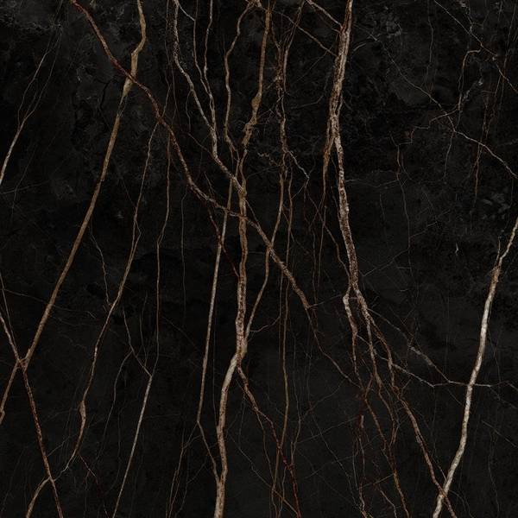
TECHLAM
232
ST-LAURENT
FINISH
SILK
THICKNESS
20 mm
FORMAT
1600x3200 mm | 63x126 inch
AVAILABLE THICKNESS
6mm | 3.5mm | 3mm
SHEET SIZE
6mm: 1600x3200 | 3mm: 1000x3000
NET WEIGHT
6mm: 14.5 kg/m2 | 3mm: 7.2 kg/m2
SERIE
TECHLAM COLLECTION
REFERENCE
WT1230
MORE VIEWS

Slide 233
TECHLAM
233
STEEL CHROME
FINISH
SILK
THICKNESS
6 mm
FORMAT
1600x3200 mm | 63x126 inch
AVAILABLE THICKNESS
6mm | 3.5mm | 3mm
SHEET SIZE
6mm: 1600x3200 | 3mm: 1000x3000
NET WEIGHT
6mm: 14.5 kg/m2 | 3mm: 7.2 kg/m2
SERIE
TECHLAM COLLECTION
REFERENCE
WT1231
MORE VIEWS

Slide 234
TECHLAM
234
STEEL-CORTEN
FINISH
SILK
THICKNESS
5 mm
FORMAT
1600x3200 mm | 63x126 inch
AVAILABLE THICKNESS
6mm | 3.5mm | 3mm
SHEET SIZE
6mm: 1600x3200 | 3mm: 1000x3000
NET WEIGHT
6mm: 14.5 kg/m2 | 3mm: 7.2 kg/m2
SERIE
TECHLAM COLLECTION
REFERENCE
WT1232
MORE VIEWS

Slide 235
TECHLAM
235
STEEL-DARK
FINISH
SILK
THICKNESS
5 mm
FORMAT
1600x3200 mm | 63x126 inch
AVAILABLE THICKNESS
6mm | 3.5mm | 3mm
SHEET SIZE
6mm: 1600x3200 | 3mm: 1000x3000
NET WEIGHT
6mm: 14.5 kg/m2 | 3mm: 7.2 kg/m2
SERIE
TECHLAM COLLECTION
REFERENCE
WT1233
MORE VIEWS

Slide 236
TECHLAM
236
STEEL-MARINE
FINISH
SILK
THICKNESS
5 mm
FORMAT
1600x3200 mm | 63x126 inch
AVAILABLE THICKNESS
6mm | 3.5mm | 3mm
SHEET SIZE
6mm: 1600x3200 | 3mm: 1000x3000
NET WEIGHT
6mm: 14.5 kg/m2 | 3mm: 7.2 kg/m2
SERIE
TECHLAM COLLECTION
REFERENCE
WT1234
MORE VIEWS

Slide 237
TECHLAM
237
STEEL-WHITE
FINISH
SILK
THICKNESS
5 mm
FORMAT
1600x3200 mm | 63x126 inch
AVAILABLE THICKNESS
6mm | 3.5mm | 3mm
SHEET SIZE
6mm: 1600x3200 | 3mm: 1000x3000
NET WEIGHT
6mm: 14.5 kg/m2 | 3mm: 7.2 kg/m2
SERIE
TECHLAM COLLECTION
REFERENCE
WT1235
MORE VIEWS

Slide 238
TECHLAM
238
STRATTOS
FINISH
POLISHED
THICKNESS
5 mm
FORMAT
1600x3200 mm | 63x126 inch
AVAILABLE THICKNESS
6mm | 3.5mm | 3mm
SHEET SIZE
6mm: 1600x3200 | 3mm: 1000x3000
NET WEIGHT
6mm: 14.5 kg/m2 | 3mm: 7.2 kg/m2
SERIE
TECHLAM COLLECTION
REFERENCE
WT1236
MORE VIEWS

Slide 239
TECHLAM
239
TAMBORA
FINISH
SILK
THICKNESS
5 mm
FORMAT
1600x3200 mm | 63x126 inch
AVAILABLE THICKNESS
6mm | 3.5mm | 3mm
SHEET SIZE
6mm: 1600x3200 | 3mm: 1000x3000
NET WEIGHT
6mm: 14.5 kg/m2 | 3mm: 7.2 kg/m2
SERIE
TECHLAM COLLECTION
REFERENCE
WT1237
MORE VIEWS

Slide 240
TECHLAM
240
TEKTONIKA
FINISH
SILK
THICKNESS
5 mm
FORMAT
1600x3200 mm | 63x126 inch
AVAILABLE THICKNESS
6mm | 3.5mm | 3mm
SHEET SIZE
6mm: 1600x3200 | 3mm: 1000x3000
NET WEIGHT
6mm: 14.5 kg/m2 | 3mm: 7.2 kg/m2
SERIE
TECHLAM COLLECTION
REFERENCE
WT1238
MORE VIEWS

Slide 241
TECHLAM
241
TESA
FINISH
SILK
THICKNESS
20 mm
FORMAT
1600x3200 mm | 63x126 inch
AVAILABLE THICKNESS
6mm | 3.5mm | 3mm
SHEET SIZE
6mm: 1600x3200 | 3mm: 1000x3000
NET WEIGHT
6mm: 14.5 kg/m2 | 3mm: 7.2 kg/m2
SERIE
TECHLAM COLLECTION
REFERENCE
WT1239
MORE VIEWS

Slide 242
TECHLAM
242
THAR
FINISH
SILK
THICKNESS
5 mm
FORMAT
1600x3200 mm | 63x126 inch
AVAILABLE THICKNESS
6mm | 3.5mm | 3mm
SHEET SIZE
6mm: 1600x3200 | 3mm: 1000x3000
NET WEIGHT
6mm: 14.5 kg/m2 | 3mm: 7.2 kg/m2
SERIE
TECHLAM COLLECTION
REFERENCE
WT1240
MORE VIEWS

Slide 243
TECHLAM
243
THUNDRA
FINISH
SILK
THICKNESS
20 mm
FORMAT
1600x3200 mm | 63x126 inch
AVAILABLE THICKNESS
6mm | 3.5mm | 3mm
SHEET SIZE
6mm: 1600x3200 | 3mm: 1000x3000
NET WEIGHT
6mm: 14.5 kg/m2 | 3mm: 7.2 kg/m2
SERIE
TECHLAM COLLECTION
REFERENCE
WT1241
MORE VIEWS

Slide 244
TECHLAM
244
TRAVERTINO PEARL
FINISH
BUSH-HAMMERED
THICKNESS
20 mm
FORMAT
1600x3200 mm | 63x126 inch
AVAILABLE THICKNESS
6mm | 3.5mm | 3mm
SHEET SIZE
6mm: 1600x3200 | 3mm: 1000x3000
NET WEIGHT
6mm: 14.5 kg/m2 | 3mm: 7.2 kg/m2
SERIE
TECHLAM COLLECTION
REFERENCE
WT1242
MORE VIEWS

Slide 245
TECHLAM
245
URBAN
FINISH
BUSH-HAMMERED
THICKNESS
5 mm
FORMAT
1600x3200 mm | 63x126 inch
AVAILABLE THICKNESS
6mm | 3.5mm | 3mm
SHEET SIZE
6mm: 1600x3200 | 3mm: 1000x3000
NET WEIGHT
6mm: 14.5 kg/m2 | 3mm: 7.2 kg/m2
SERIE
TECHLAM COLLECTION
REFERENCE
WT1243
MORE VIEWS

Slide 246
TECHLAM
246
VULCANO COAL
FINISH
SILK
THICKNESS
6 mm
FORMAT
1600x3200 mm | 63x126 inch
AVAILABLE THICKNESS
6mm | 3.5mm | 3mm
SHEET SIZE
6mm: 1600x3200 | 3mm: 1000x3000
NET WEIGHT
6mm: 14.5 kg/m2 | 3mm: 7.2 kg/m2
SERIE
TECHLAM COLLECTION
REFERENCE
WT1244
MORE VIEWS

Slide 247
TECHLAM
247
VULCANO-CENIZA
FINISH
SILK
THICKNESS
5 mm
FORMAT
1600x3200 mm | 63x126 inch
AVAILABLE THICKNESS
6mm | 3.5mm | 3mm
SHEET SIZE
6mm: 1600x3200 | 3mm: 1000x3000
NET WEIGHT
6mm: 14.5 kg/m2 | 3mm: 7.2 kg/m2
SERIE
TECHLAM COLLECTION
REFERENCE
WT1245
MORE VIEWS

Slide 248
TECHLAM
248
VULCANO-CONCRETE
FINISH
MATTE
THICKNESS
5 mm
FORMAT
1600x3200 mm | 63x126 inch
AVAILABLE THICKNESS
6mm | 3.5mm | 3mm
SHEET SIZE
6mm: 1600x3200 | 3mm: 1000x3000
NET WEIGHT
6mm: 14.5 kg/m2 | 3mm: 7.2 kg/m2
SERIE
TECHLAM COLLECTION
REFERENCE
WT1246
MORE VIEWS

Slide 249
TECHLAM
249
VULCANO-ROCA
FINISH
SILK
THICKNESS
5 mm
FORMAT
1600x3200 mm | 63x126 inch
AVAILABLE THICKNESS
6mm | 3.5mm | 3mm
SHEET SIZE
6mm: 1600x3200 | 3mm: 1000x3000
NET WEIGHT
6mm: 14.5 kg/m2 | 3mm: 7.2 kg/m2
SERIE
TECHLAM COLLECTION
REFERENCE
WT1247
MORE VIEWS

Slide 250
TECHLAM
250
ZAHIR-PERLE
FINISH
SILK
THICKNESS
5 mm
FORMAT
1600x3200 mm | 63x126 inch
AVAILABLE THICKNESS
6mm | 3.5mm | 3mm
SHEET SIZE
6mm: 1600x3200 | 3mm: 1000x3000
NET WEIGHT
6mm: 14.5 kg/m2 | 3mm: 7.2 kg/m2
SERIE
TECHLAM COLLECTION
REFERENCE
WT1248
MORE VIEWS

Slide 251
WHARTONSTONE
251
CHINA PANDA WHITE BNL826048L 2600X800X15MM MANUFACTURER, FACTORY | WHARTON
FINISH
POLISHED
THICKNESS
15 mm
FORMAT
1600x3200 mm | 63x126 inch
AVAILABLE THICKNESS
6mm | 3.5mm | 3mm
SHEET SIZE
6mm: 1600x3200 | 3mm: 1000x3000
NET WEIGHT
6mm: 14.5 kg/m2 | 3mm: 7.2 kg/m2
SERIE
WHARTON ORIGINAL
REFERENCE
WT1249
MORE VIEWS

Slide 252
NEOLITH
252
LA BOHÈME | TIMBER
FINISH
SILK
THICKNESS
6 mm
FORMAT
1600x3200 mm | 63x126 inch
AVAILABLE THICKNESS
6mm | 3.5mm | 3mm
SHEET SIZE
6mm: 1600x3200 | 3mm: 1000x3000
NET WEIGHT
6mm: 14.5 kg/m2 | 3mm: 7.2 kg/m2
SERIE
WOOD SERIES
REFERENCE
WT01
MORE VIEWS

Slide 253
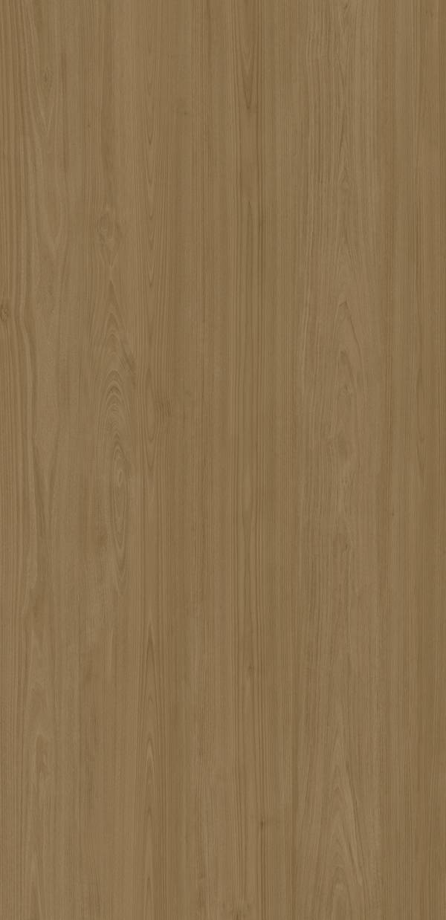
NEOLITH
253
PASADENA | TIMBER
FINISH
SILK
THICKNESS
6 mm
FORMAT
1600x3200 mm | 63x126 inch
AVAILABLE THICKNESS
6mm | 3.5mm | 3mm
SHEET SIZE
6mm: 1600x3200 | 3mm: 1000x3000
NET WEIGHT
6mm: 14.5 kg/m2 | 3mm: 7.2 kg/m2
SERIE
WOOD SERIES
REFERENCE
WT1251
MORE VIEWS

Slide 254
NEOLITH
254
SUMMER DALA | TIMBER
FINISH
SILK
THICKNESS
6 mm
FORMAT
1600x3200 mm | 63x126 inch
AVAILABLE THICKNESS
6mm | 3.5mm | 3mm
SHEET SIZE
6mm: 1600x3200 | 3mm: 1000x3000
NET WEIGHT
6mm: 14.5 kg/m2 | 3mm: 7.2 kg/m2
SERIE
WOOD SERIES
REFERENCE
WT1252
MORE VIEWS

Slide 255
CONTACT
WEB
TEL
apple@whartonstone.com
www.whartonstone.com
+86 139 2313 0743
Expert in 3 & 6MM Ultra-Thin Sintered Stone
© 2026 Wharton Ultra-Thin Stone | 253 Products | www.whartonstone.com

